Slide 1
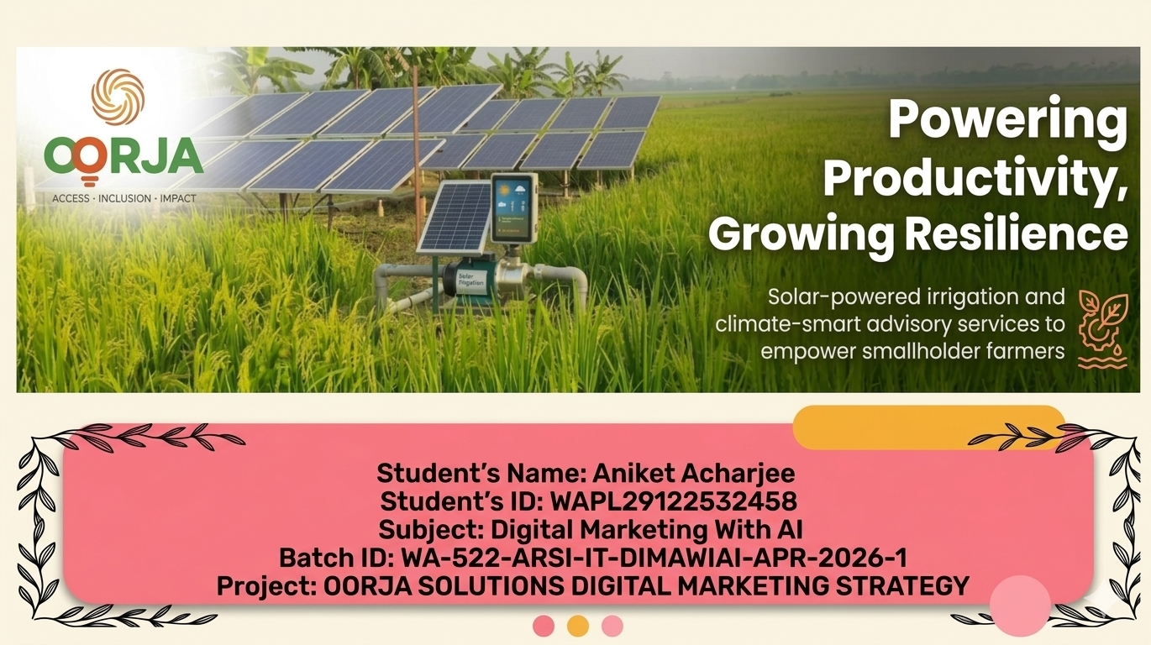

Slide 2
Oorja digital
marketing strategy
Oorja Solutions
SEO, content & paid advertising strategy

Slide 3
TABLE OF CONTENT
Business & Technical SEO Audit
SEO Strategy, Research & Advertising
Marketing Channels & Team Operations
BUSINESS UNDERSTANDING
BUSINESS OBJECTIVE
BUSINESS CHALLENGES
CURRENT SCENARIOS (SEO AUDIT)
OVERALL SEO AUDIT
DOMAIN AUTHORITY SCORE
WEBSITE TRAFFIC ANALYSIS
WEBSITE ORGANIC TRAFFIC ANALYSIS
KEYWORD CONSISTENCY ANALYSIS
PAGE RENDERING CHECK
PAGE SPEED CHECK MOBILE
PAGE SPEED CHECK DESKTOP
MOBILE FRIENDLINESS TEST
IMPROVEMENT RECOMMENDATIONS
SUGGESTIVE KEY IMPROVEMENT AREAS
4 PILLARS OF SEO
SEO PLAN SUMMARY ACTIVITIES
TARGET LOCATION
TARGET AUDIENCE
TOTAL ADDRESSABLE MARKET(FUNNEL)
COMPETITOR ANALYSIS
KEYWORD RESEARCH, CLUSTERING, MAPPING
STRATEGY/ROADMAP
BLOG CONTENT FOR SEO
PPC PART ANALYSIS
AD COPY DESIGN
TYPES OF AD
SOCIAL MEDIA TYPES OF AD
SOCIAL MEDIA CONTENT CALENDER
EMAIL MARKETING
WHATSAPP MARKETING
SMS MARKETING
LANDING PAGE STRUCTURE
SEO KPIS TO TRACK
ORGANIZATION TEAM STRUCTURE
ACCOUNTABILITY
ACTIVITIES

Slide 4





Business understandings
Oorja Development Solutions: Simplified flow
Farmer partnerships
Pay-per-use model
Oonnati: Solar irrigation
Oorvar: Agri advisory
Low-income, smallholder farmers are engaged.
Removing upfront capital costs.
Sustainable farming advice.
Reliable water access.
Farm impact & sustainability
Higher yields & revenue
Reduced diesel use & emissions
Local green jobs & gender smart practices

Slide 5


Business summary
Farming-as-a-Service marketplace focused on sustainable agriculture and clean energy.
Founders
Founded in
Amit Saraogi, Audrey Fillon
2016
Key investors & grant backers
REPIC, BASE, Seeding The Future Foundation, IFT, Miller Center
Primary competition
Khethworks, Claro Energy, Ecozen, Agrosolar India
Headquarters
Business model
New Delhi, India
B2B, B2C (Pay-Per-Use)

Slide 6


About US
Oorja Development Solutions is a pioneering Farming-as-a-Service (FaaS) enterprise operating at the intersection of clean energy and sustainable agriculture. We provide community-level, solar-powered irrigation and climate-smart advisory services to low-income smallholder farmers in India. By championing an innovative Pay-Per-Use subscription model, Oorja eliminates heavy upfront technology costs—successfully delivering affordable, reliable green energy access to the last farmer in line.
Our solutions
Key impacts
OONNATI: Solar Irrigation (Pay-Per-Use)
OORVAR: Farmer Training (Climate-Smart Advice)
Boost Income: Up to 33% higher revenue
Reduce Costs: Cut fuel & water expenses by 60%
Scale: 389 Solar Pumps deployed & 402 projects
Green Jobs: 310+ local operators employed
Environment: 8,187 tons CO2e saved annually

Slide 7




Business objectives
Remove Upfront Capital Barriers
Enhance Agricultural Productivity
Promote Climate-Smart Agriculture
Empower Rural Communities
Transition low-income smallholders from expensive diesel to clean energy using an affordable, risk-free Pay-Per-Use subscription model.
Deploy community-level solar irrigation grids (Oonnati) to ensure reliable, year-round water access.
Train farmers through customised advisory services (Oorvar) to adopt vermicompost, rebuild soil health, and cut chemical inputs by 48%.
Boost smallholder farm revenues by 33% and generate sustainable local employment by hiring community members as system operators.
Core Objectives
Desired Outcomes
Remove Upfront Capital Barriers
Deploy Community Solar Irrigation Grids
Eliminate Dependence on Diesel Pumps
Increase Smallholder Farm Incomes by 33%
Train Farmers in Climate-Smart Agriculture
Mitigate 8,187 tons of CO2e Annually

Slide 8
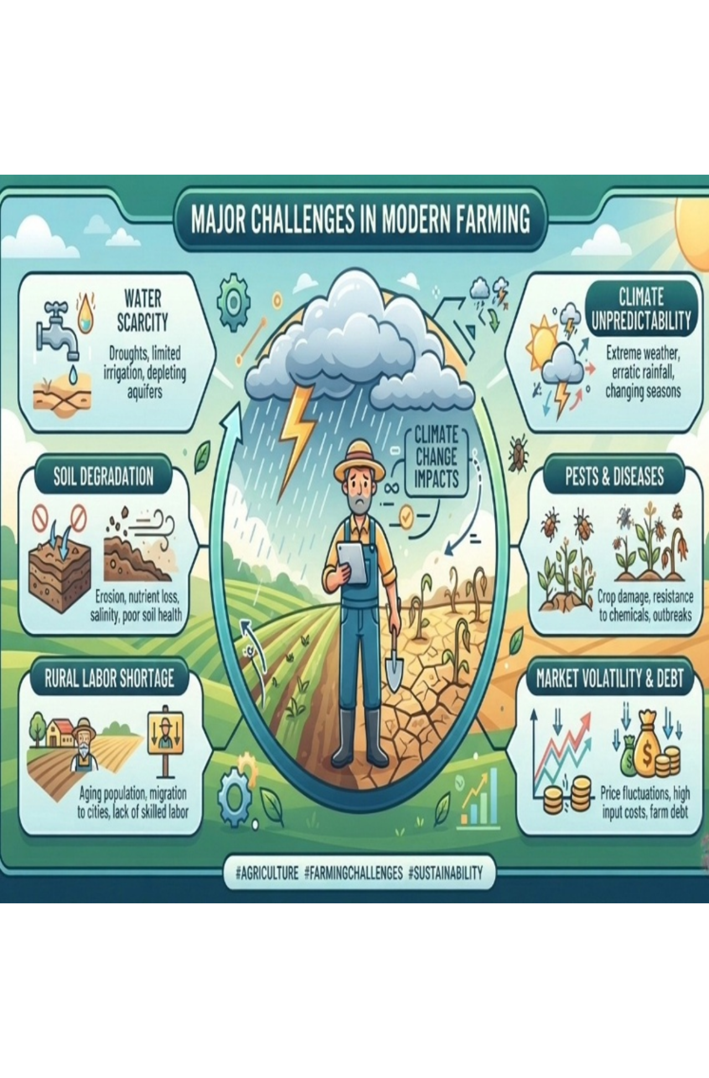




Business Challenges
Climate Unpredictability
Water Scarcity
Extreme weather and erratic rainfall disrupt crop cycles.
Droughts, falling aquifers, and little reliable irrigation.
Soil Degradation
Pests & Diseases
Erosion, nutrient loss, and high salinity degrade soil.
Crop damage and rising resistance to chemical treatments.
Market Volatility & Debt
Rural Labor Shortage
Price swings, high input costs, and mounting farm debt.
Aging workforce, few skilled workers, and youth migrating to cities.

Slide 9
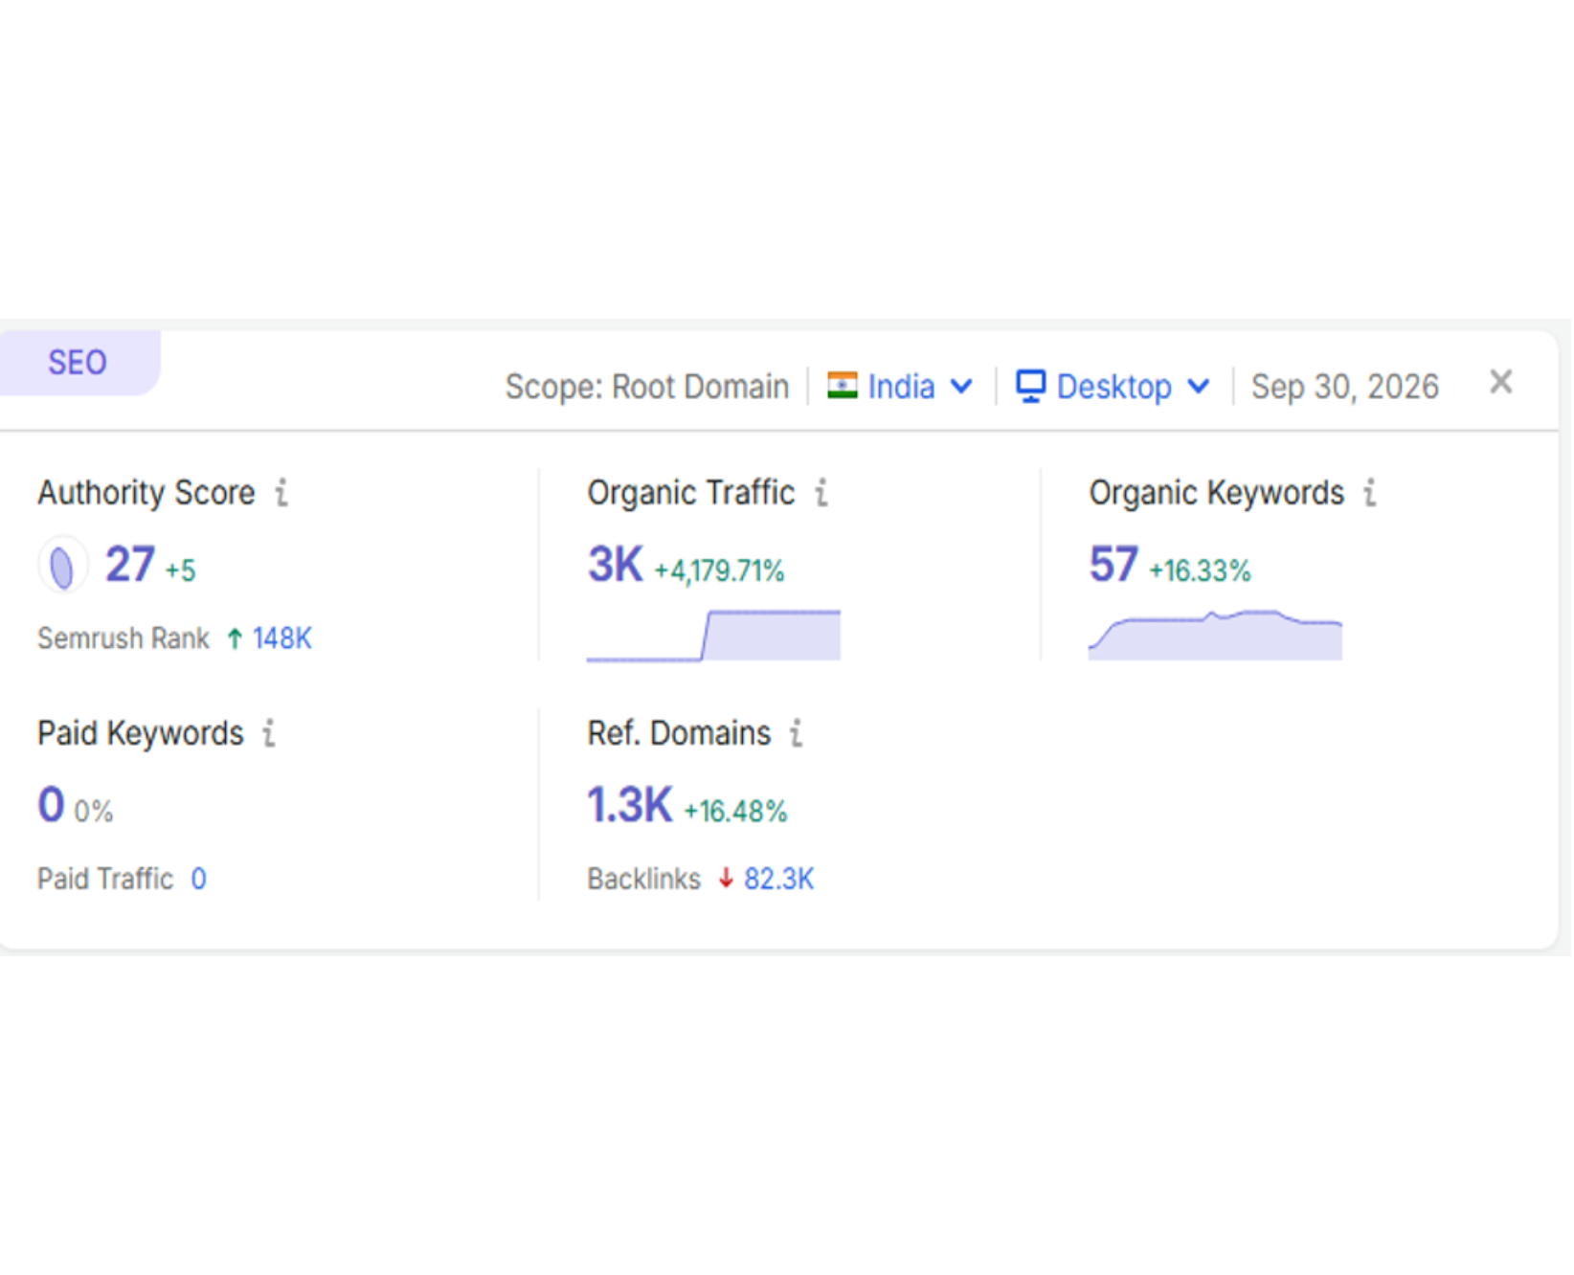
Website Current Scenario And Growth Plan
Massive Traffic Spike: Organic desktop traffic from India up 4,179.71% to 3,000 monthly visits.
Rankings Improving: Gained 148,000 global spots; Authority Score is 27.
Backlink Cleanup: Linking sites grew to 1,300 (+16.48%) while total backlinks fell by 82,300.
Concentrated Keywords: Only 57 organic keywords (+16.33%); a few top terms drive new traffic.
100% Organic: No paid ads, 0 paid keywords, 0 paid traffic.
Source: SEMRUSH

Slide 10
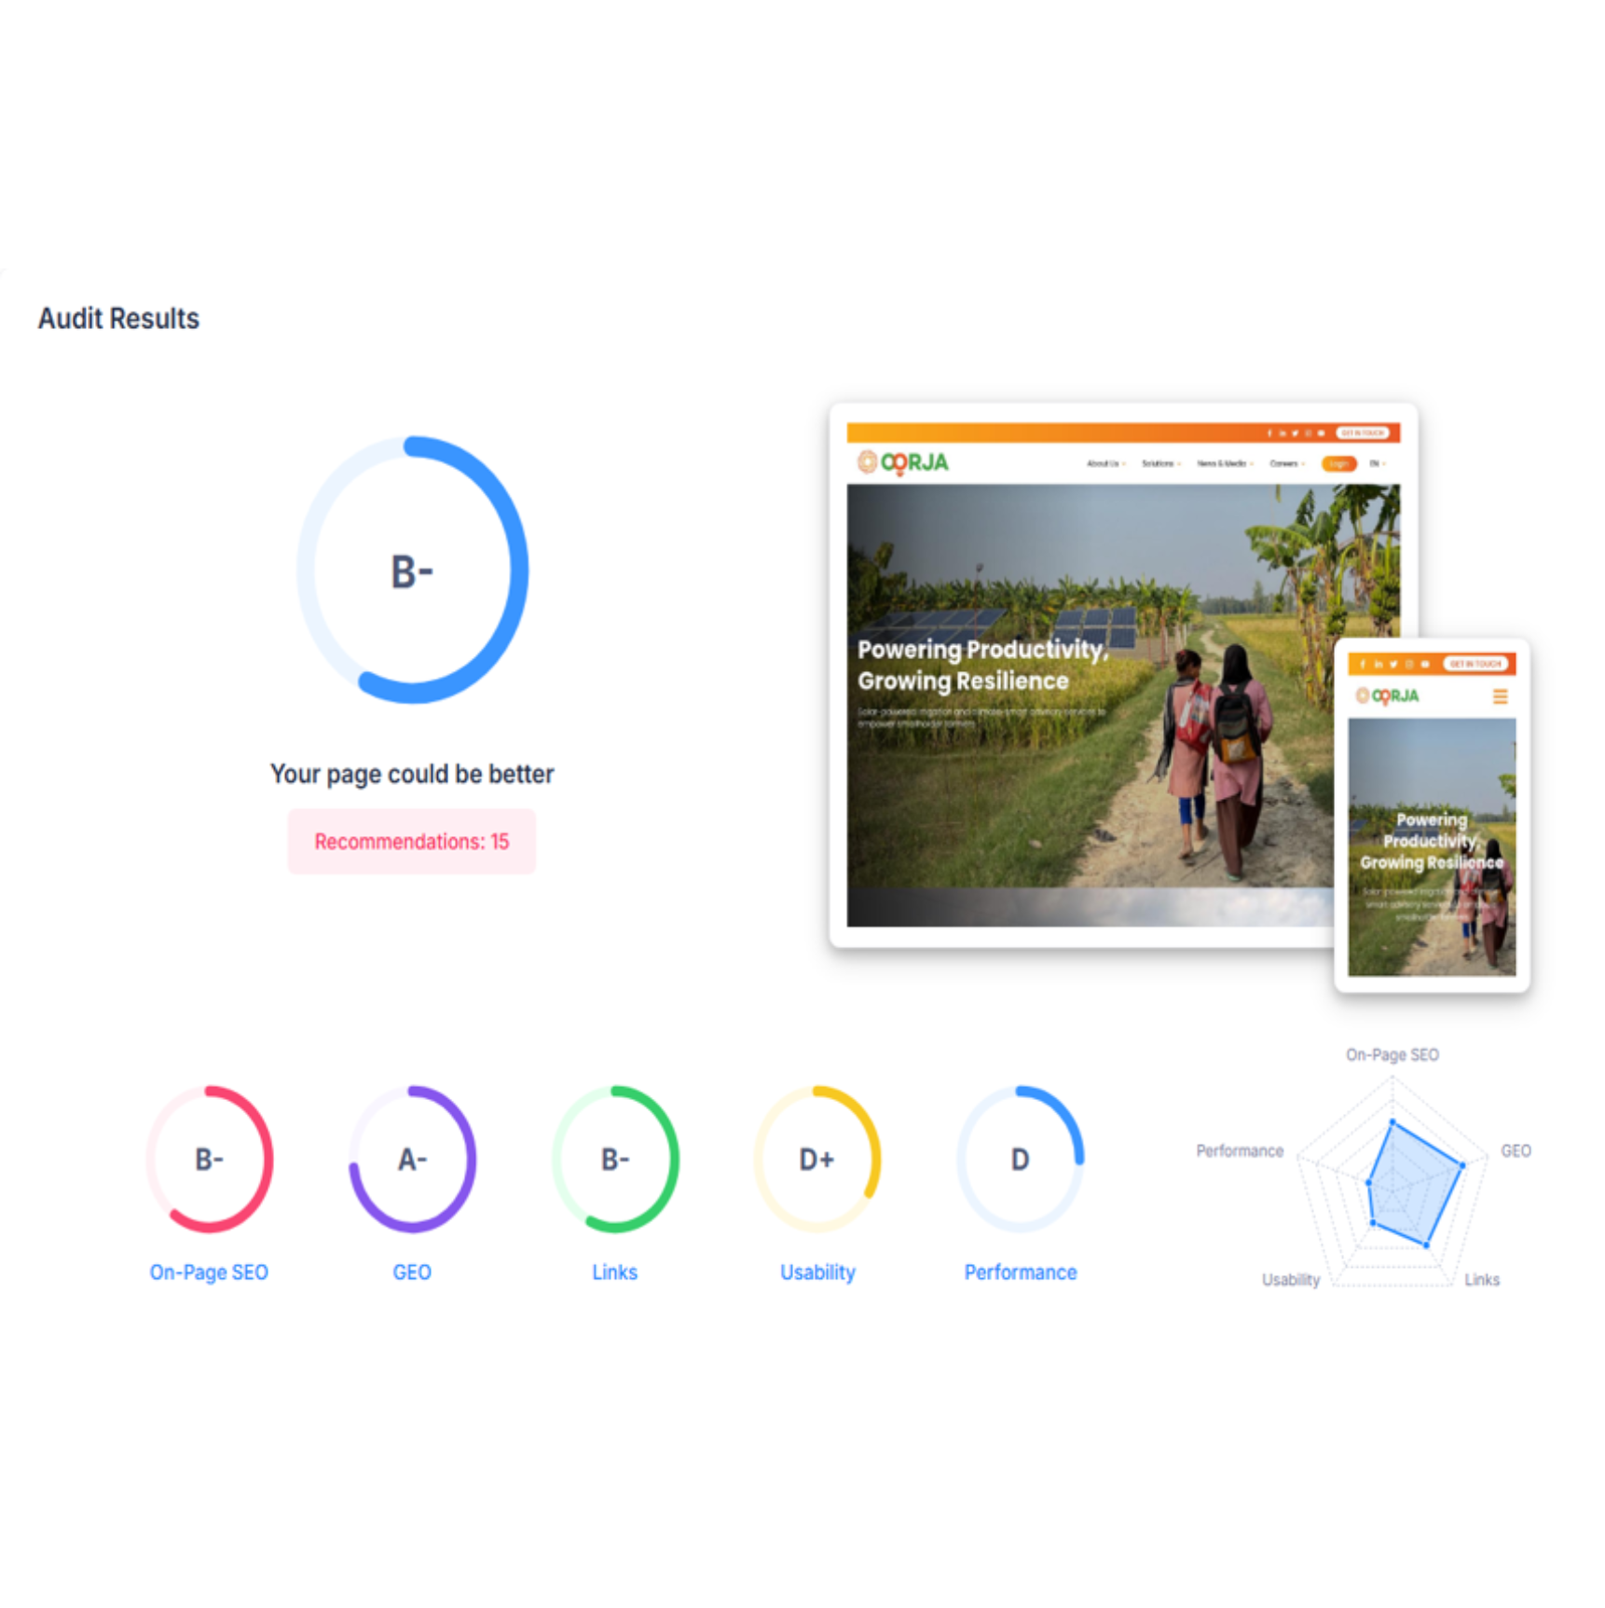
Overall SEO audit
Overall grade B- with 15 recommended fixes
On-Page SEO (B-)
Good fundamentals; needs content and keyword refinement.
SEO (A-)
The site's highest mark: clean basic search parameters.
Links (B-)
Moderate backlink quality and internal linking.
Usability (D+)
Poor mobile and desktop accessibility; needs immediate attention.
Performance (D)
Weakest category: critical page loading delays and slow server response.
Source: SEOPTIMER

Slide 11
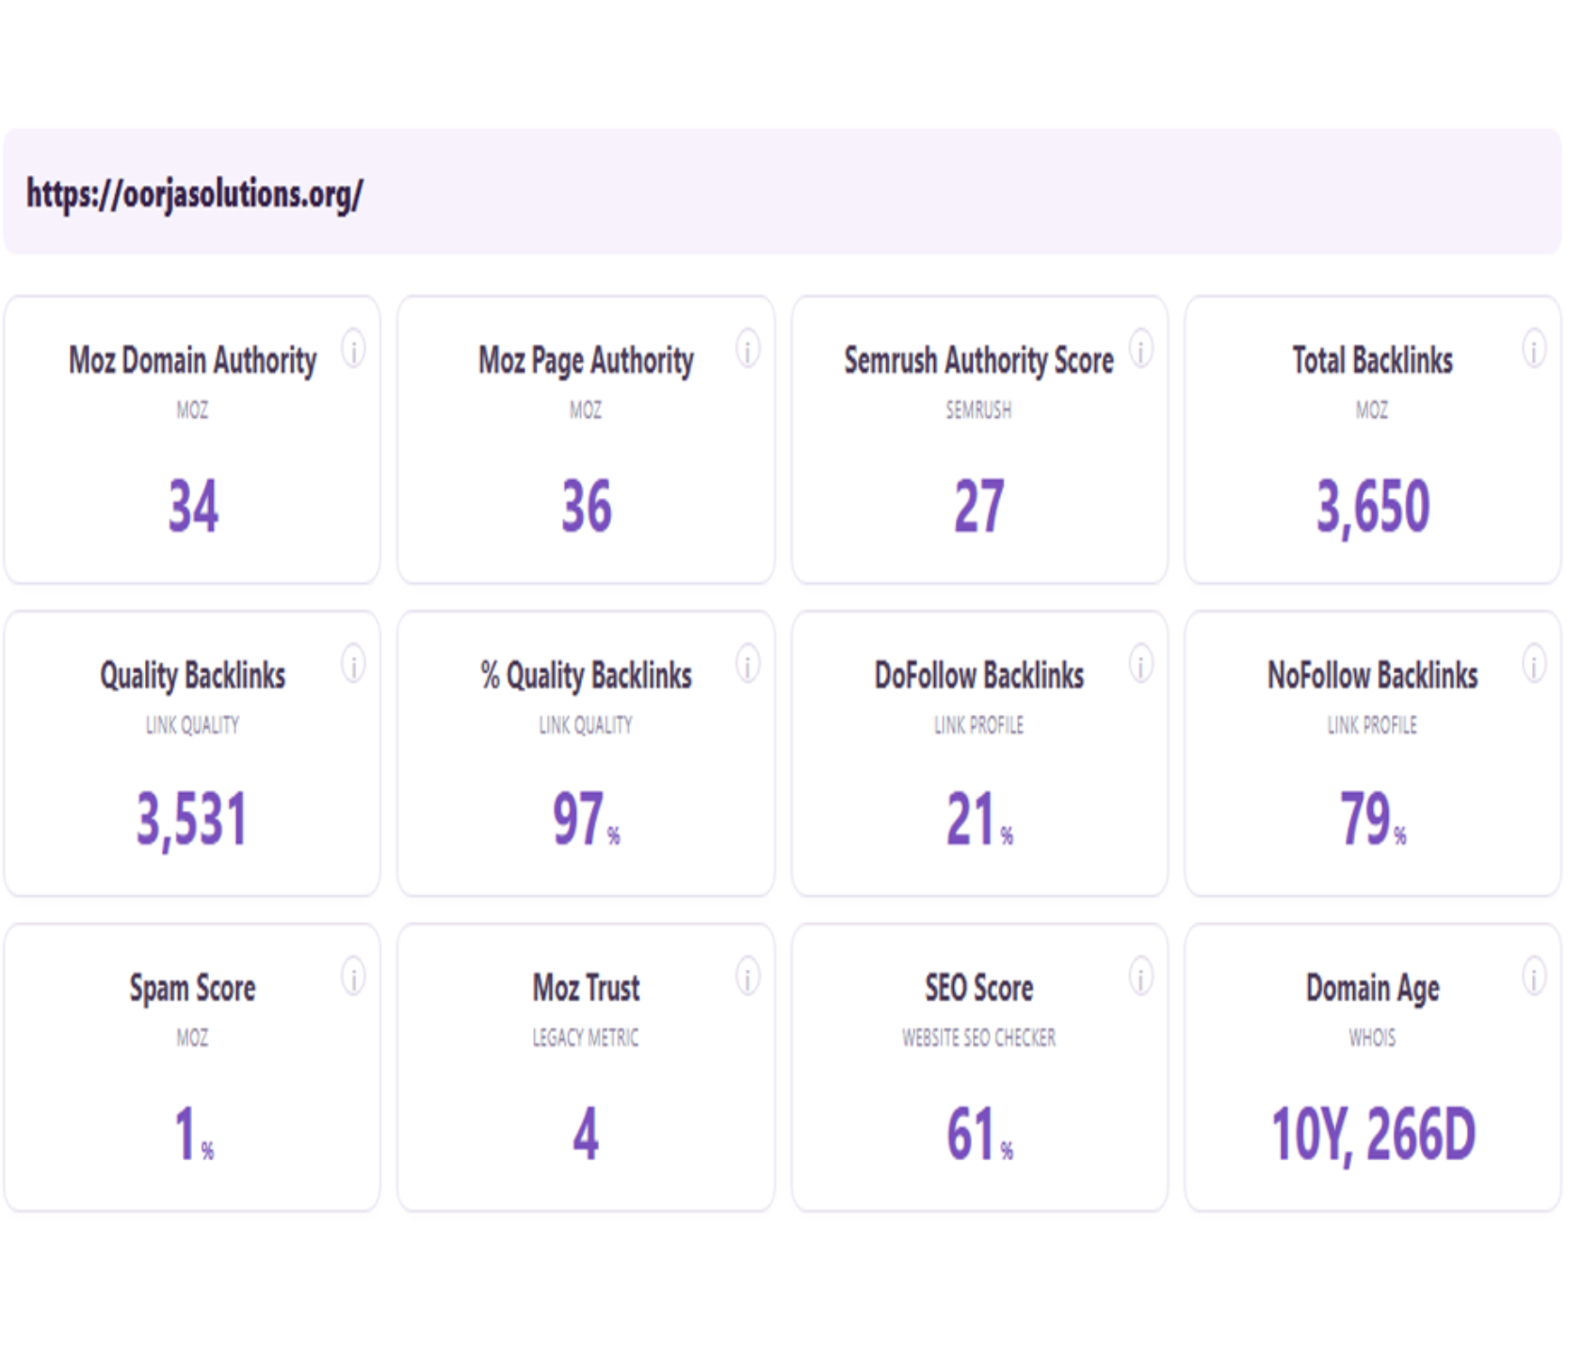
Website authority
Website authority report: oorjasolutions.org
Website authority report: oorjasolutions.org
Authority scores
Moz Domain Authority 34, Page Authority 36, Semrush Authority Score 27: solid mid-tier authority over a domain age of 10 years and 266 days.
Backlink quality profile
97% of 3,650 backlinks (3,531) are quality links, with a minimal 1% spam score.
Link type discrepancy
Only 21% are DoFollow (pass link equity); 79% are NoFollow, the main area to optimize.
Please note, the data presented is subject to change over time due to evolving metrics such as performance fluctuations, strategic adjustments, and external market dynamics
Source: websiteseochecker

Slide 12
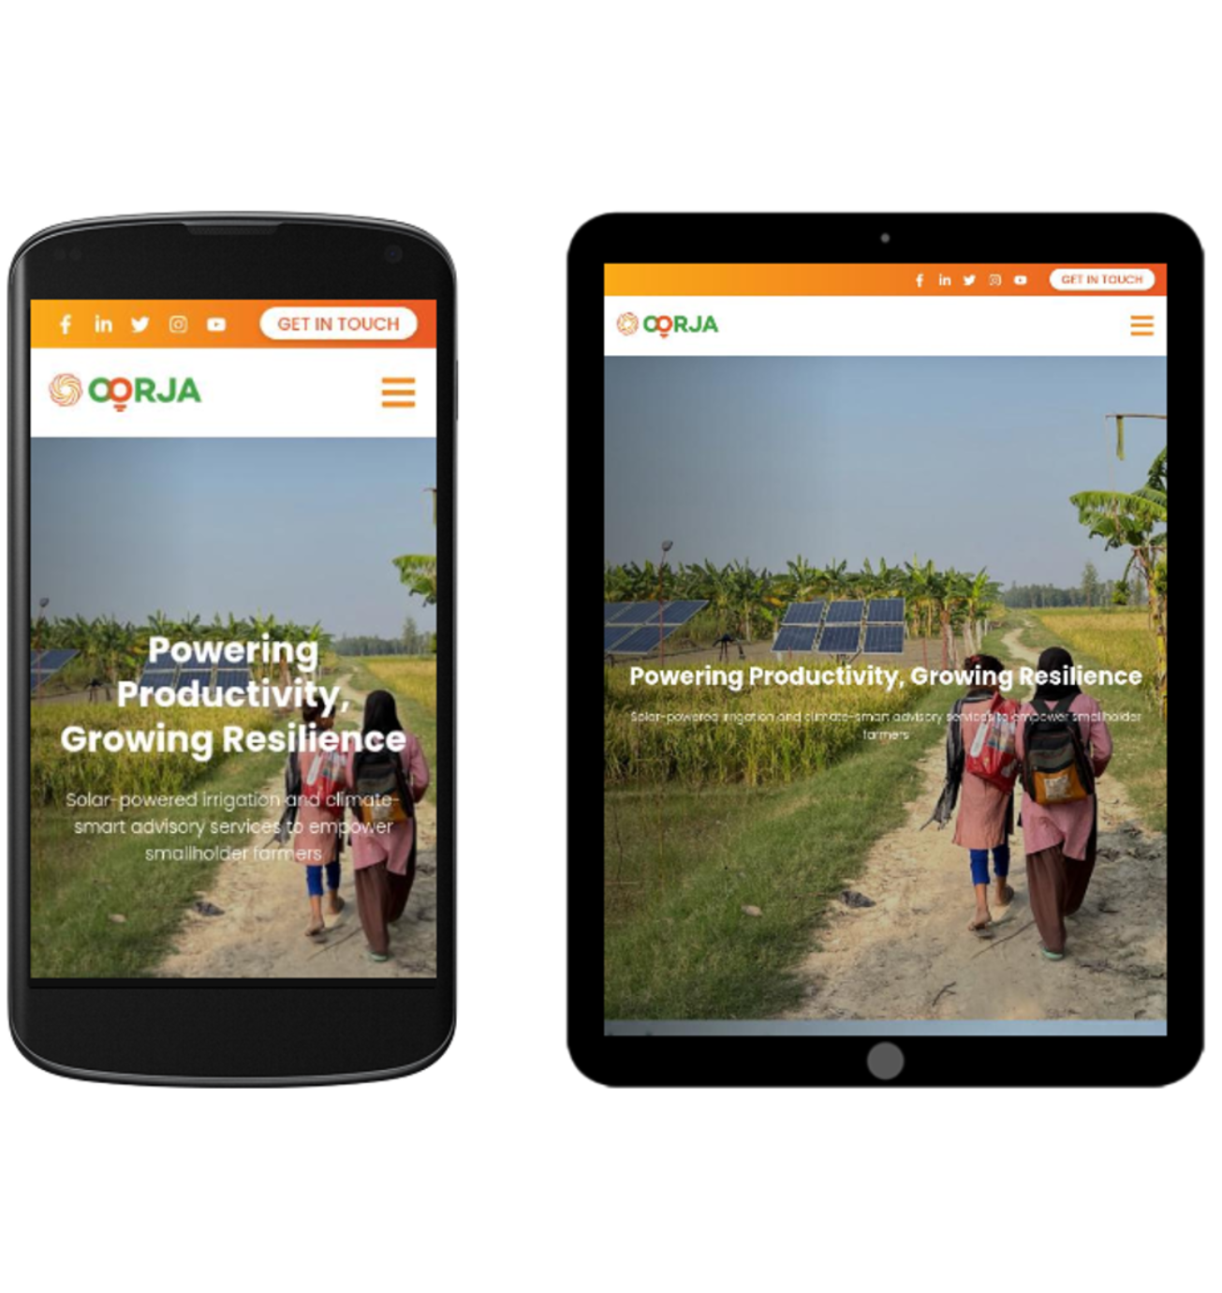
Page rendering check
Mobile phone viewport
Layout scales cleanly; navigation collapses into a hamburger menu beside the OORJA logo.
Tablet viewport
The header stretches wider, giving the social row whitespace and a wider hero image.
Text readability over images
Add a semi-transparent dark tint or soft text shadow to meet WCAG 2.1 contrast.
Mobile-first indexing
Hamburger menu content must match the desktop sitemap exactly.
Please note, the data presented is subject to change over time due to evolving metrics such as performance fluctuations, strategic adjustments, and external market dynamics
Source: SEOPTIMER
Footer links
Secondary footer links should not disappear on mobile breakpoints.

Slide 13
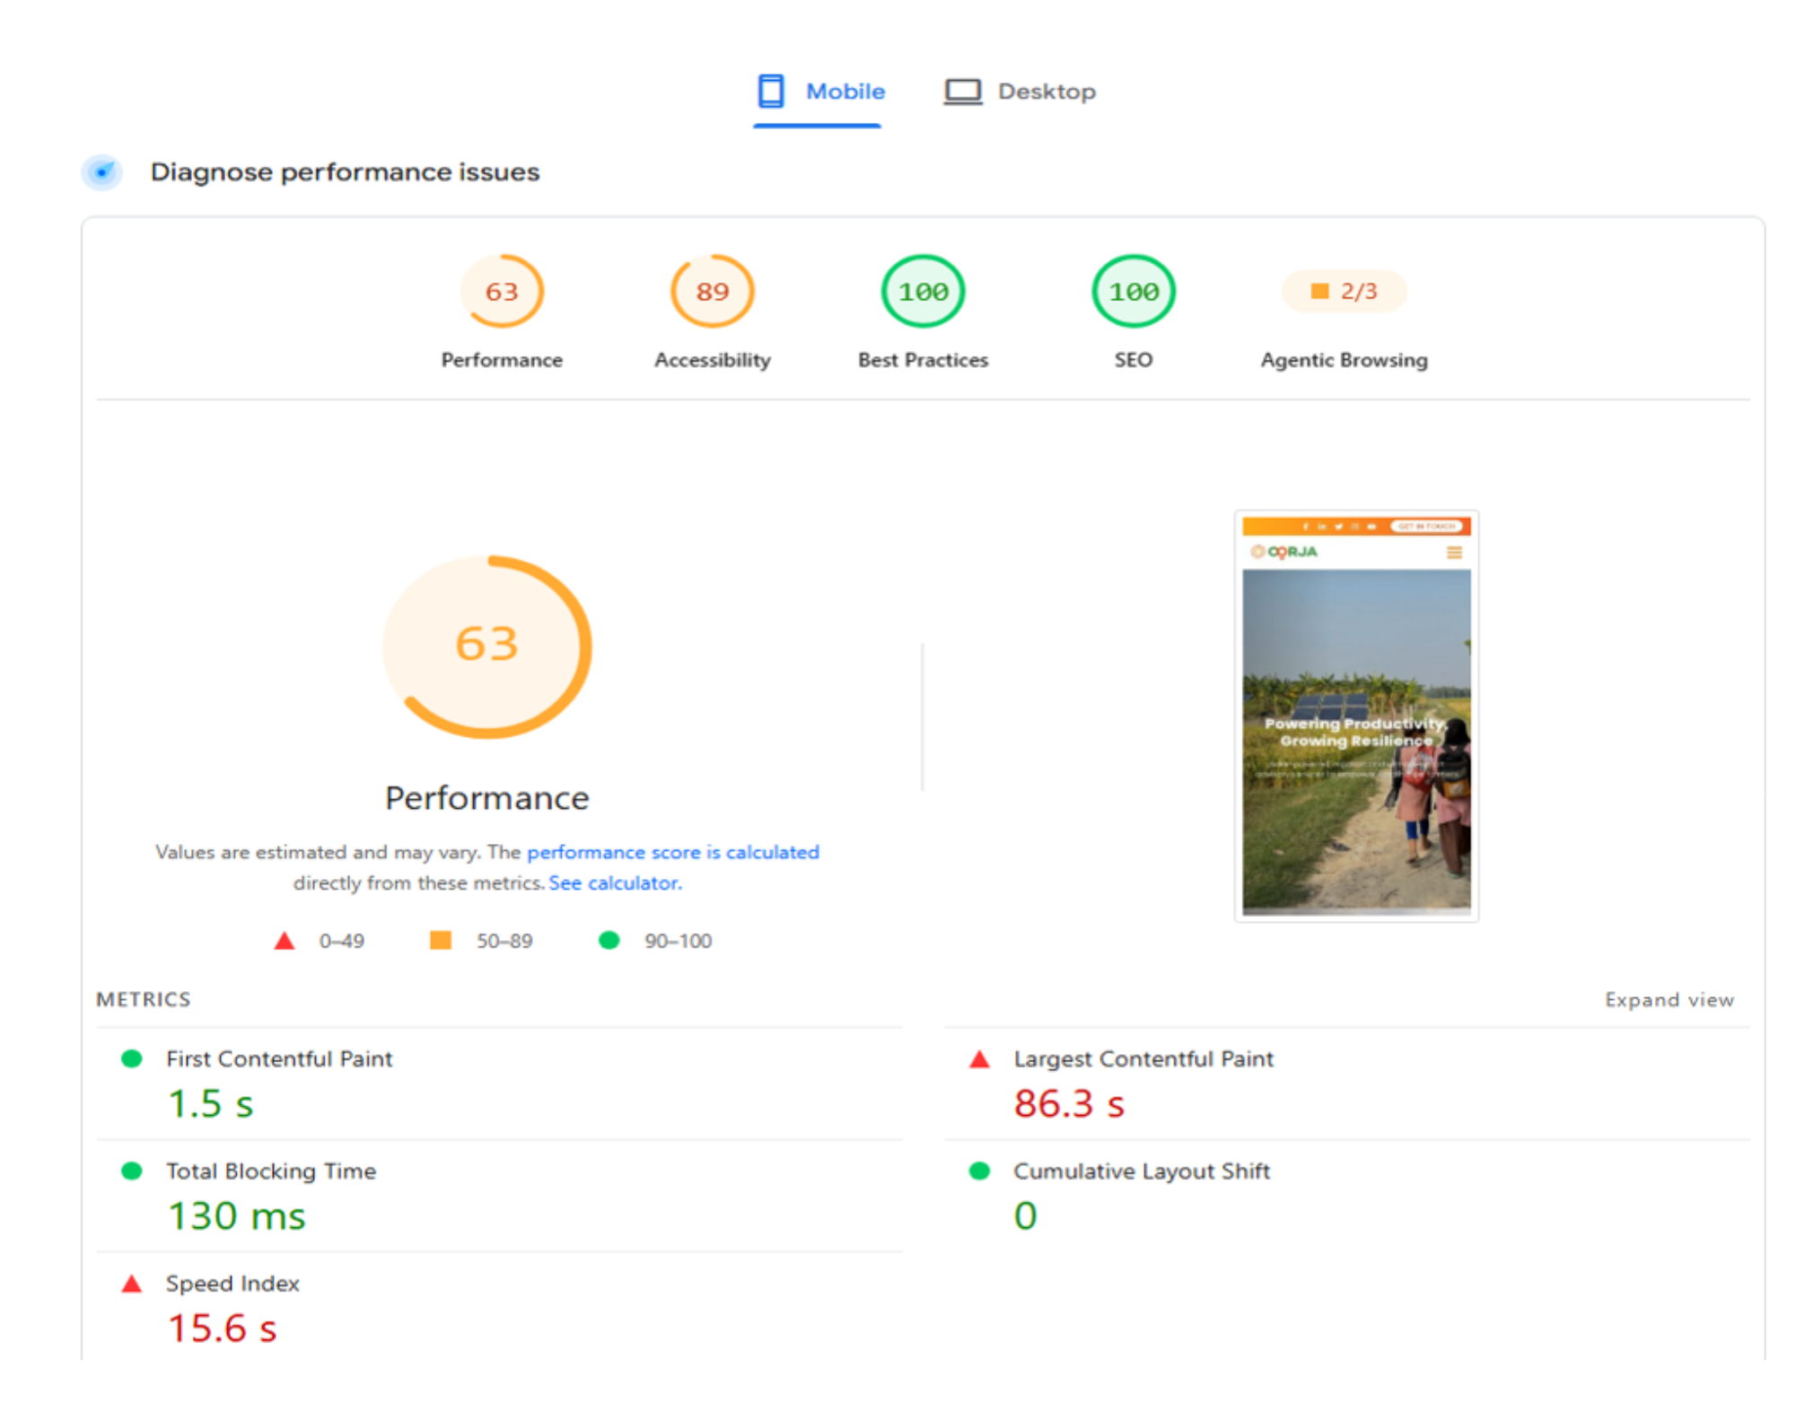
Page speed check: mobile
Insights
Top-tier optimization
Perfect 100/100 for SEO and Best Practices, and a strong 89 for Accessibility.
Performance bottleneck
Overall Performance drops to 63 because of critical loading delays.
Severe loading delay
Largest Contentful Paint takes 86.3 seconds, so the hero image shows far too late on mobile.
Slow visual setup
Speed Index is high at 15.6 seconds, delaying a fully populated page.
Stable layout
Please note, the data presented is subject to change over time due to evolving metrics such as performance fluctuations, strategic adjustments, and external market dynamics
Source: Page Insights
Cumulative Layout Shift is a perfect 0; nothing jumps while loading.

Slide 14
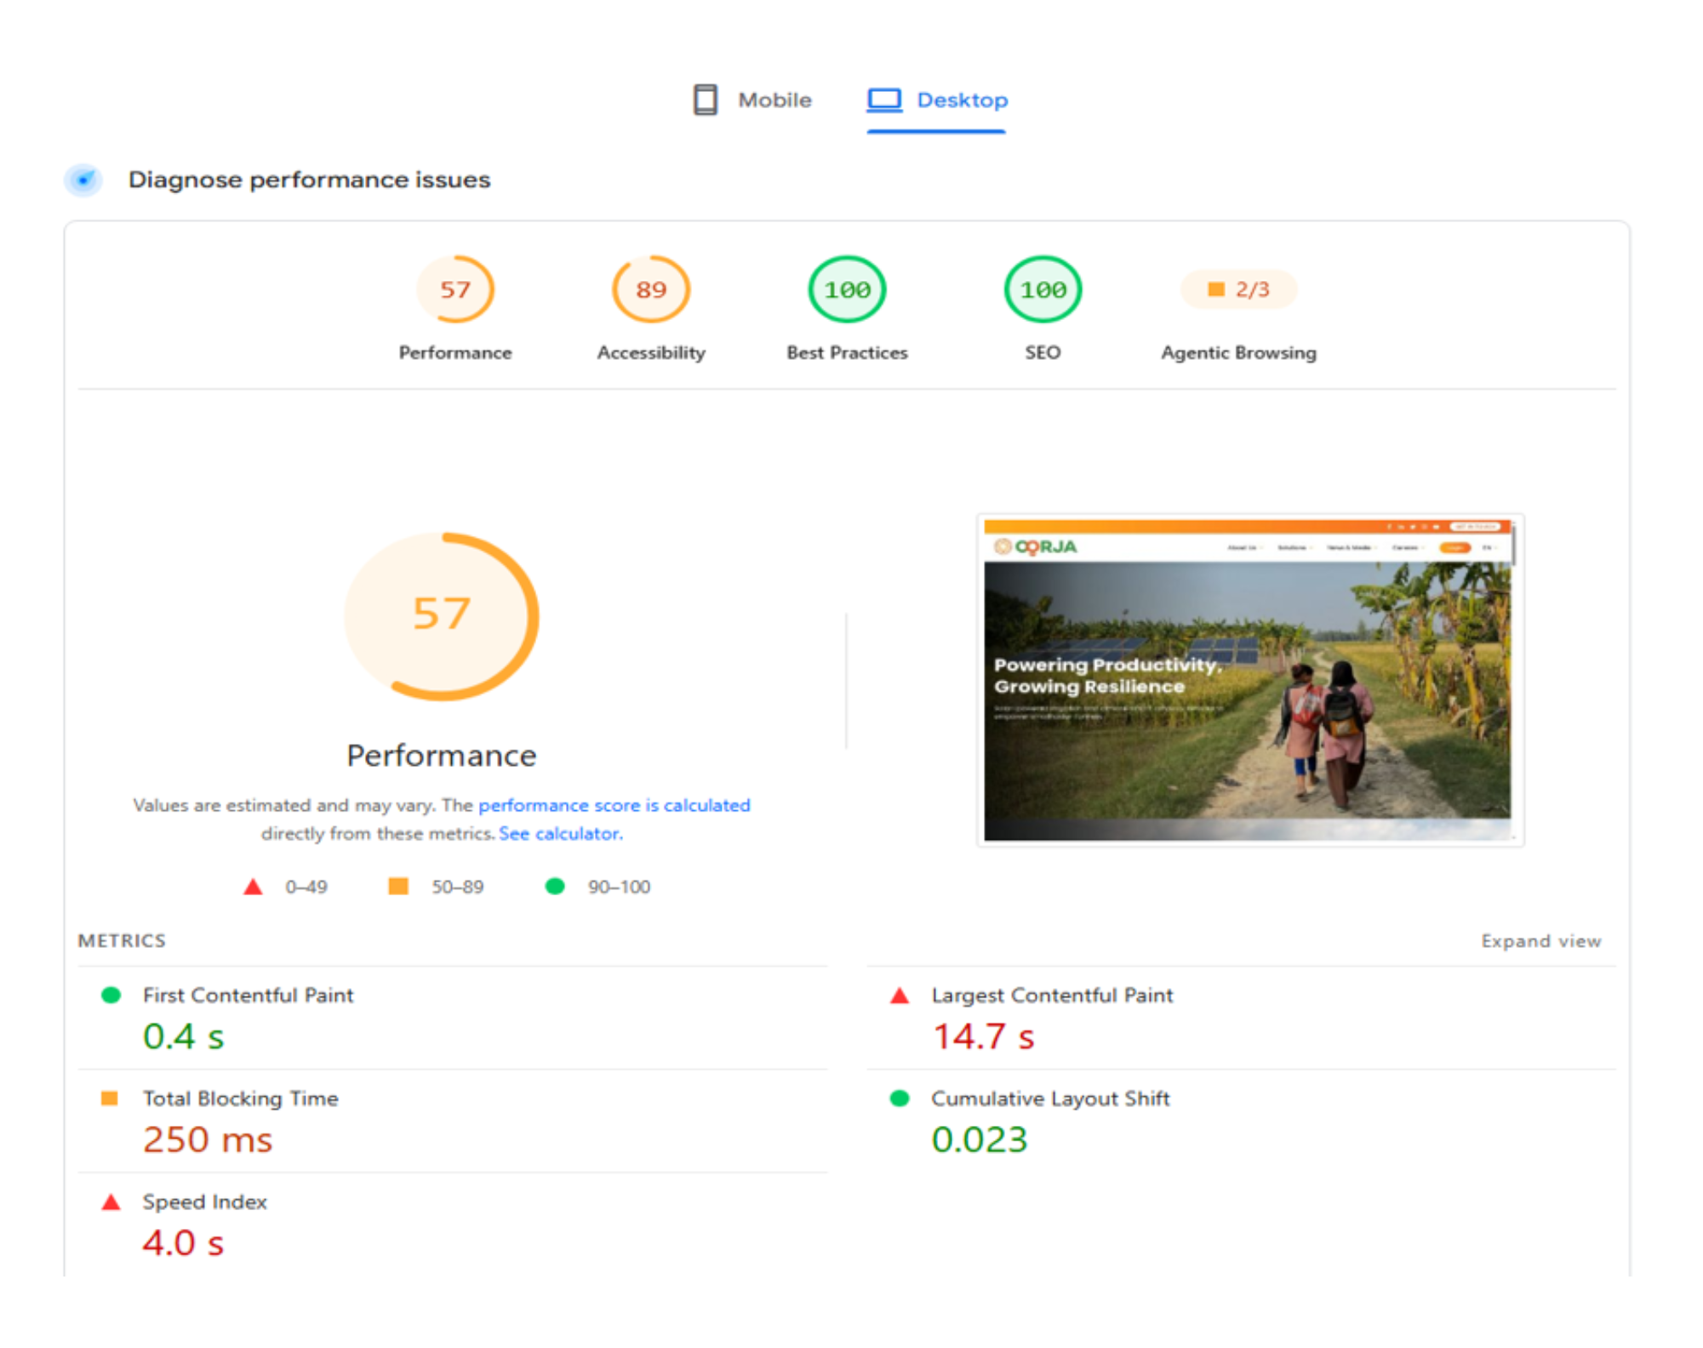
Page speed check: desktop
Insights
Perfect scores, slow load
Best Practices and SEO are 100/100, but Performance is 57/100 because the page loads visually too slowly.
The main problem
Largest Contentful Paint is 14.7 seconds; the solar-panel hero banner should show in under 2.5 seconds.
Compress the main image
Convert the banner to a modern format like WebP or AVIF to shrink its file size.
Prioritize banner loading
Remove loading="lazy" from the hero image and add fetchpriority="high" so the browser loads it immediately.
Preload the asset
Please note, the data presented is subject to change over time due to evolving metrics such as performance fluctuations, strategic adjustments, and external market dynamics
Source: Page Speed Insights
Add a <link rel="preload"> tag in the HTML header for that image.

Slide 15

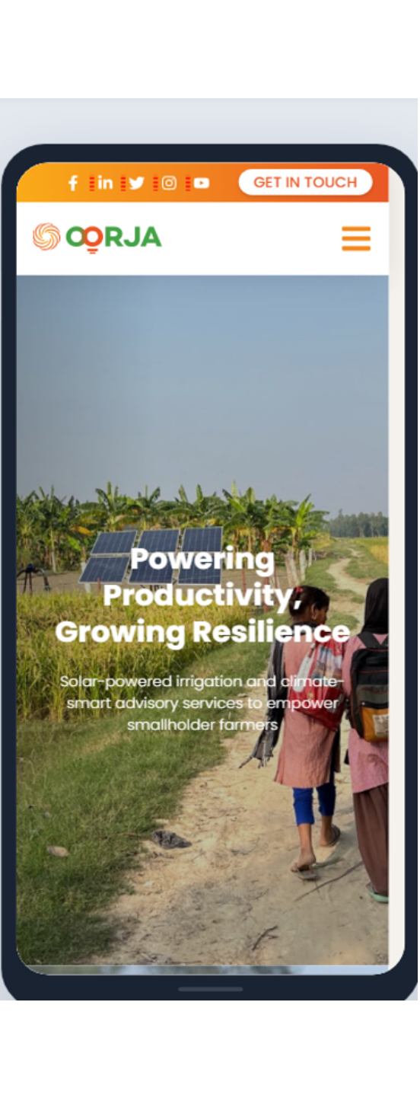
Mobile friendliness
Key observations
IPHONE 15
S24
Excellent visual continuity
The mobile site scales cleanly across iPhone 15 and Galaxy S24, keeping the solar panels and landscape centred.
Strong brand identity
The orange header (#F16522) against clean white makes the menu and Get In Touch button instantly visible.
Font legibility challenges
White hero text blends into the bright sky and field on sunlit mobile screens.
Source: Mobile Viewer

Slide 16
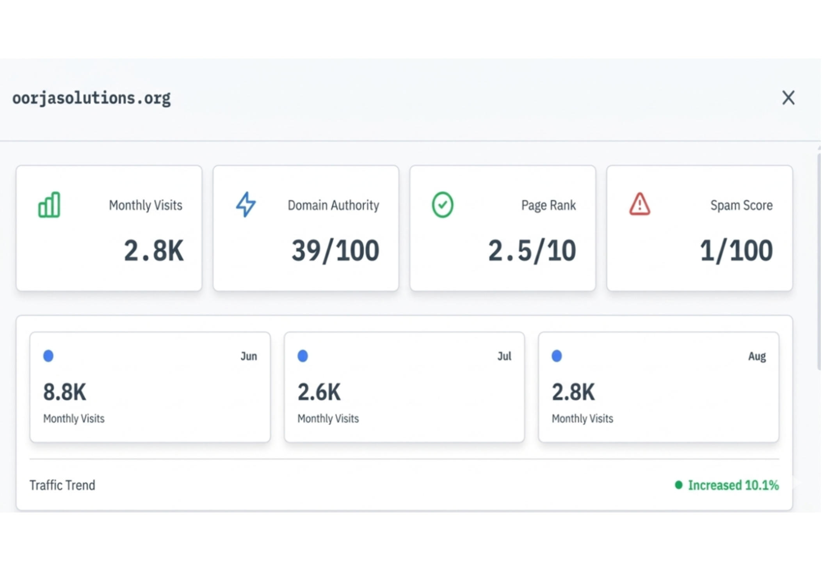
Website traffic analysis
Traffic trend analysis
August recovery
Monthly traffic sits at 2.8K visits, a modest 10.1% increase from July's low of 2.6K.
The June collapse
Despite the recent uptick, traffic is still down by over 68% compared to June's 8.8K visits.
Please note, the data presented is subject to change over time due to evolving metrics such as performance fluctuations, strategic adjustments, and external market dynamics
Source: trafficchecker.net

Slide 17
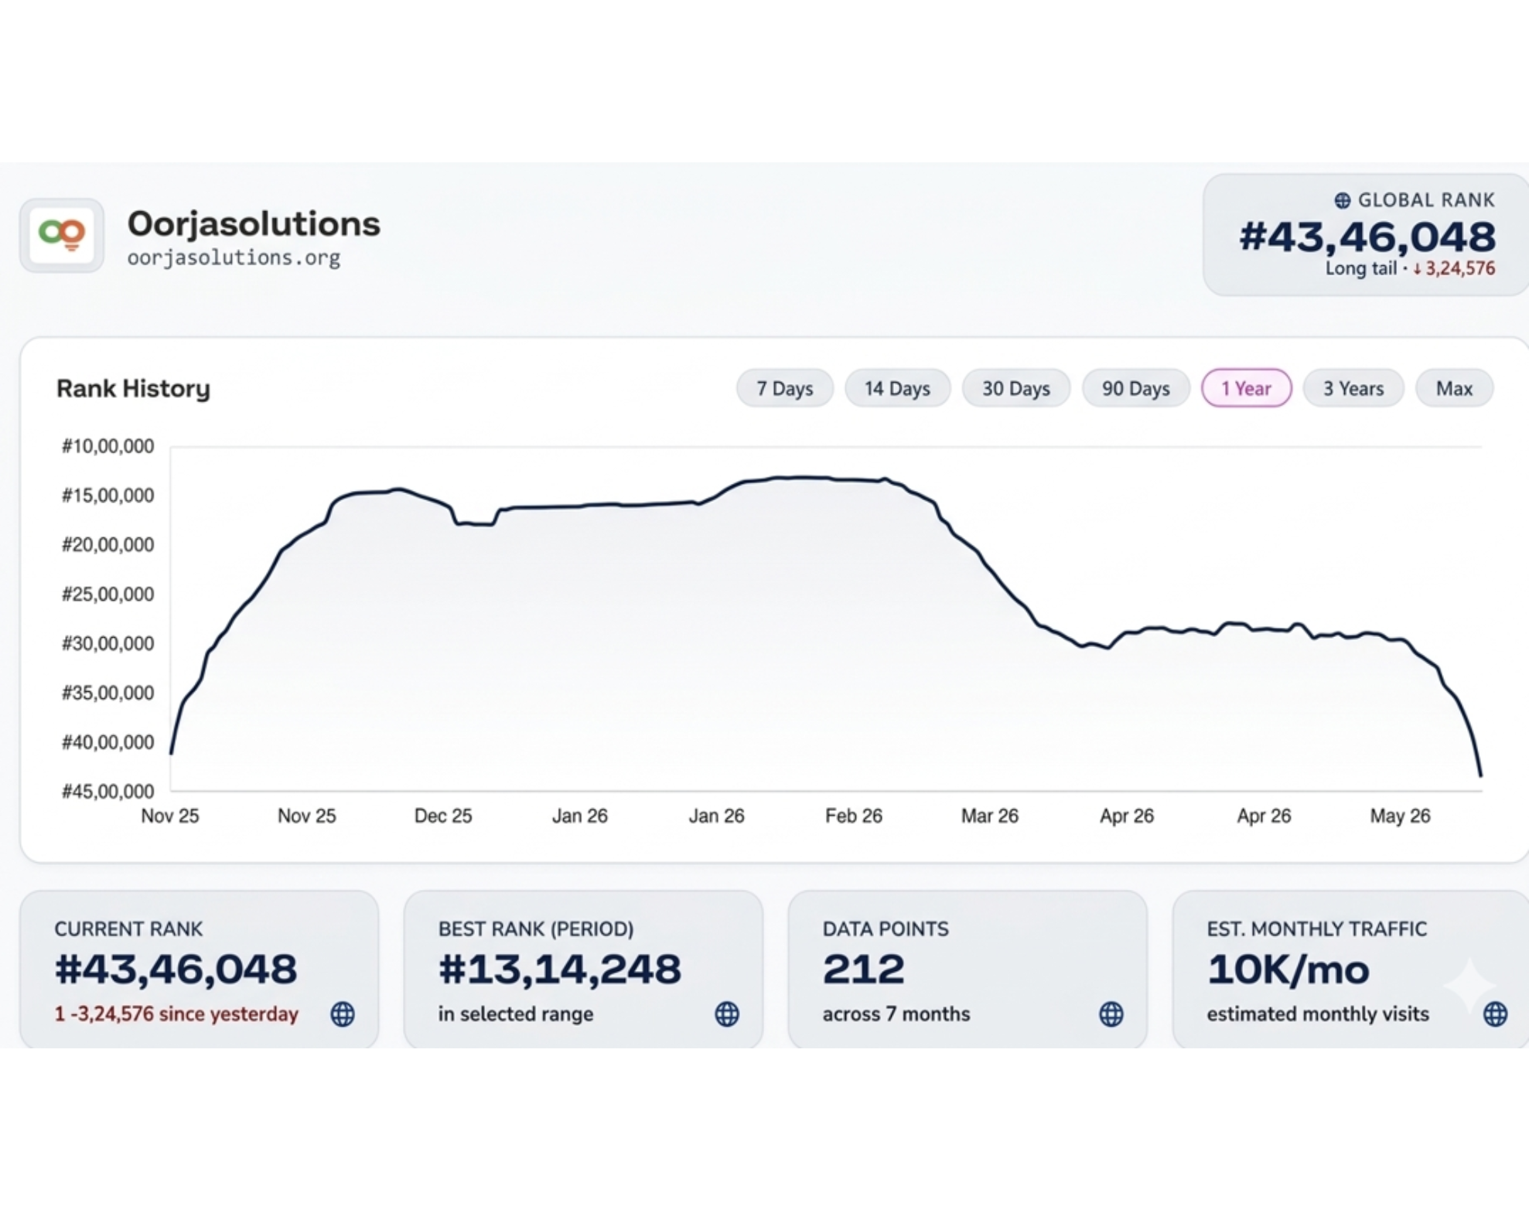
Website traffic analysis: rank history
Insights
The main crisis: ranking collapse
Peaked at #1,314,248 between Dec '25 and Feb '26; now plunged to #4,346,048.
Recent acceleration
Rank fell by 324,576 positions since yesterday alone, a worsening downward spiral.
Likely cause
Search engines are probably penalizing the 96% bounce rate and 14.7s loading lag.
Metric breakdown
10K/mo is an average; real-time traffic has dried up. 212 data points over 7 months show a clear decline.
Please note, the data presented is subject to change over time due to evolving metrics such as performance fluctuations, strategic adjustments, and external market dynamics
Source: trafficchecker.net

Slide 18
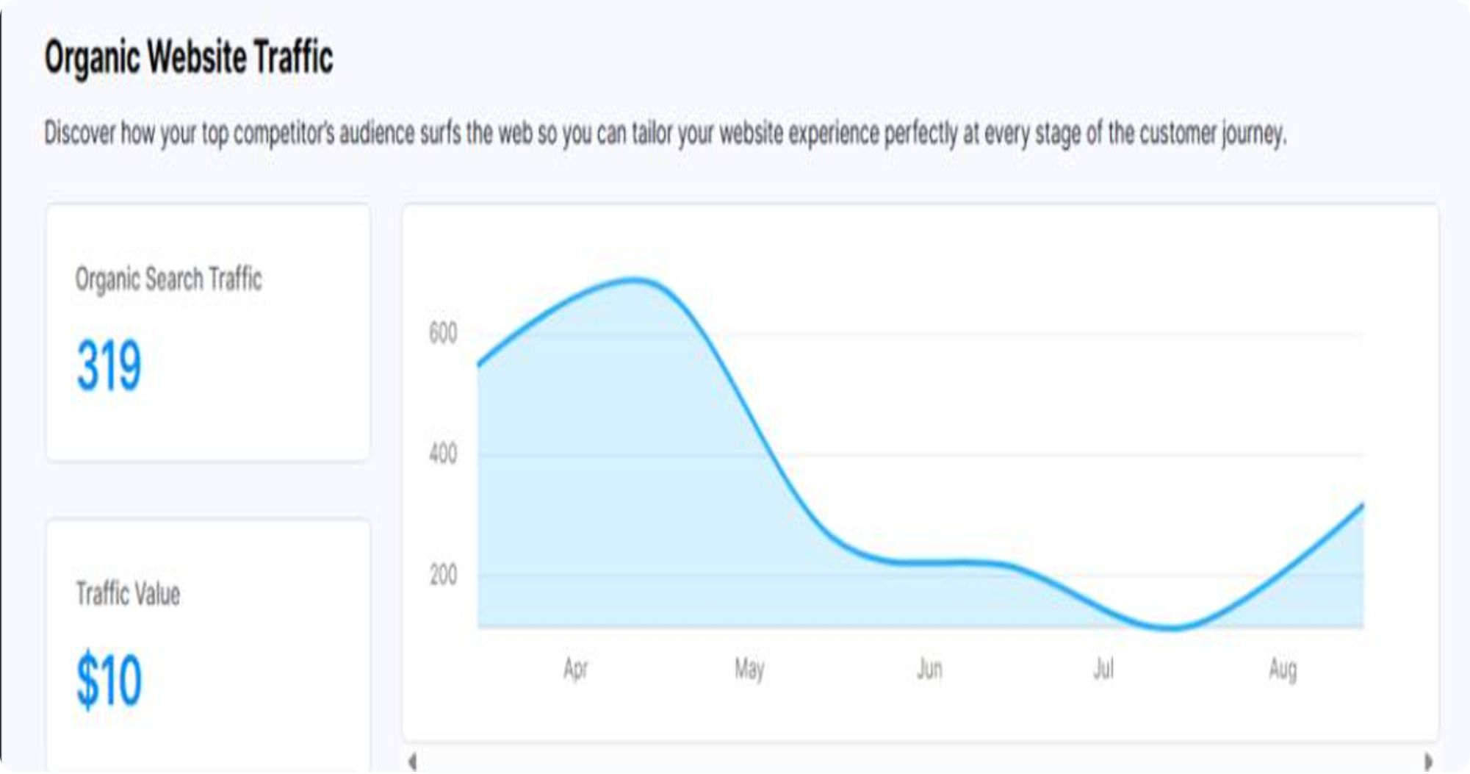
Insights
Organic traffic analysis
The crash
Peaked in mid-April at over 600 monthly visits, collapsed through May, bottomed near 100 in July.
The August recovery
Back on a steady upward trend, climbing to 319 organic visits.
Organic search traffic (319)
Still down roughly 50% from the April peak, though recovering.
Please note, the data presented is subject to change over time due to evolving metrics such as performance fluctuations, strategic adjustments, and external market dynamics
Traffic value ($10)
Very low commercial worth: the site ranks mostly for low-competition brand or informational terms.
Source: Backlinko

Slide 19
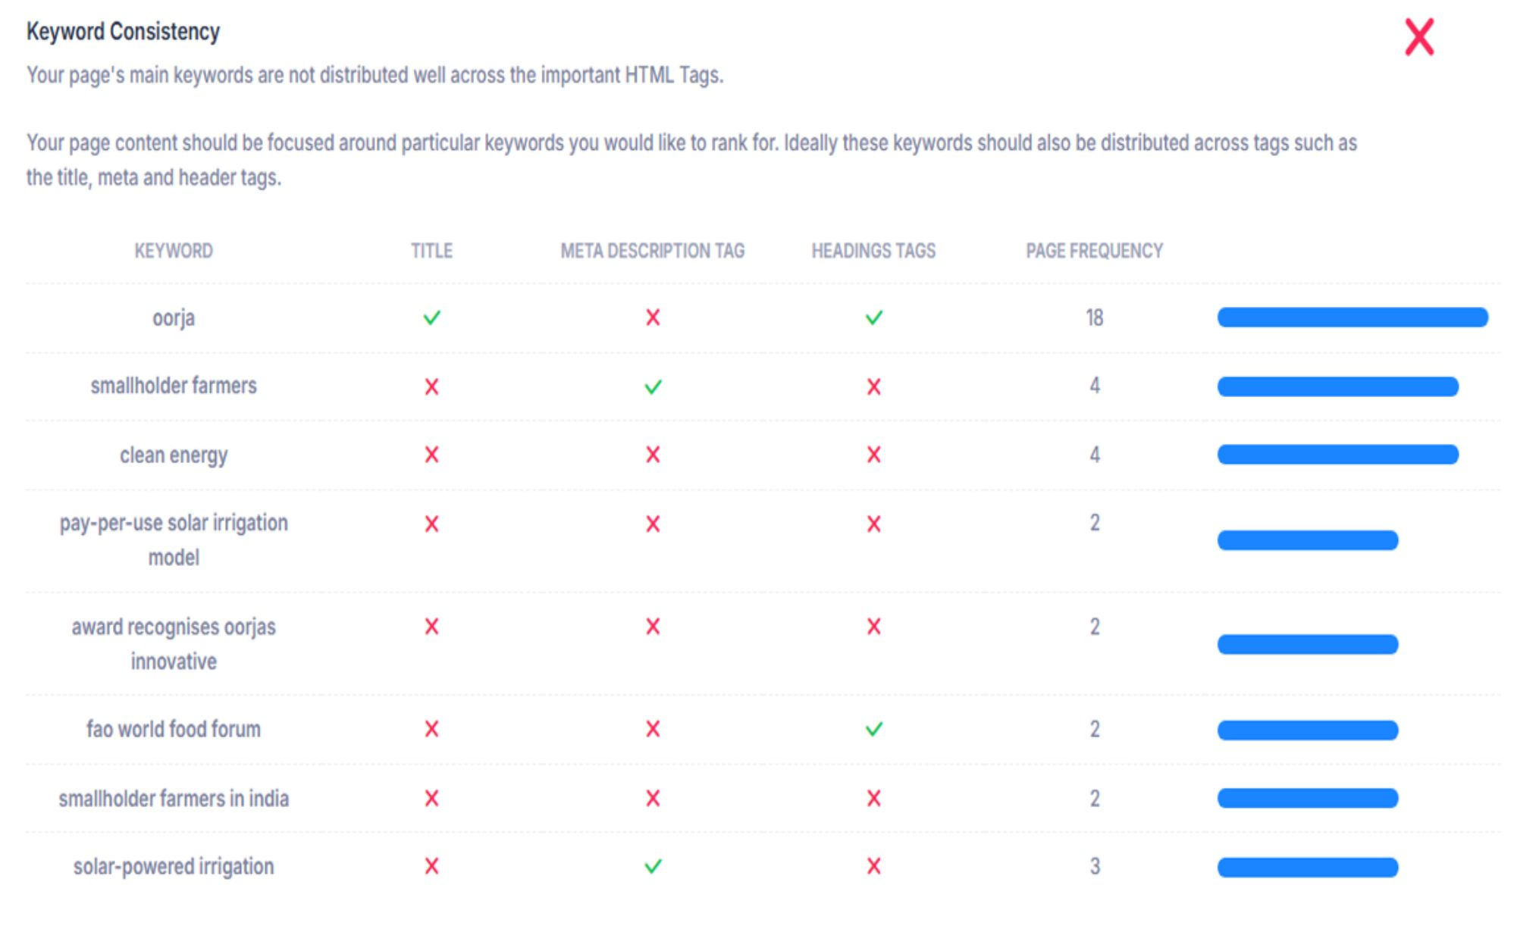
Insights
Keyword consistency
The main crisis
Core keywords are missing from the title, meta description and headings, explaining the $10 traffic value.
Missing money terms
“clean energy” and “pay-per-use solar irrigation model” show a red X on every key tag.
Brand only
“oorja” appears 18 times and is in the title, but not the meta description.
Quick fixes
Please note, the data presented is subject to change over time due to evolving metrics such as performance fluctuations, strategic adjustments, and external market dynamics
Brand and service in the title; “clean energy” and “solar-powered irrigation” in the meta description; “Pay-Per-Use Solar Irrigation Model” in H1/H2.
Source: SEOPTIMER

Slide 20
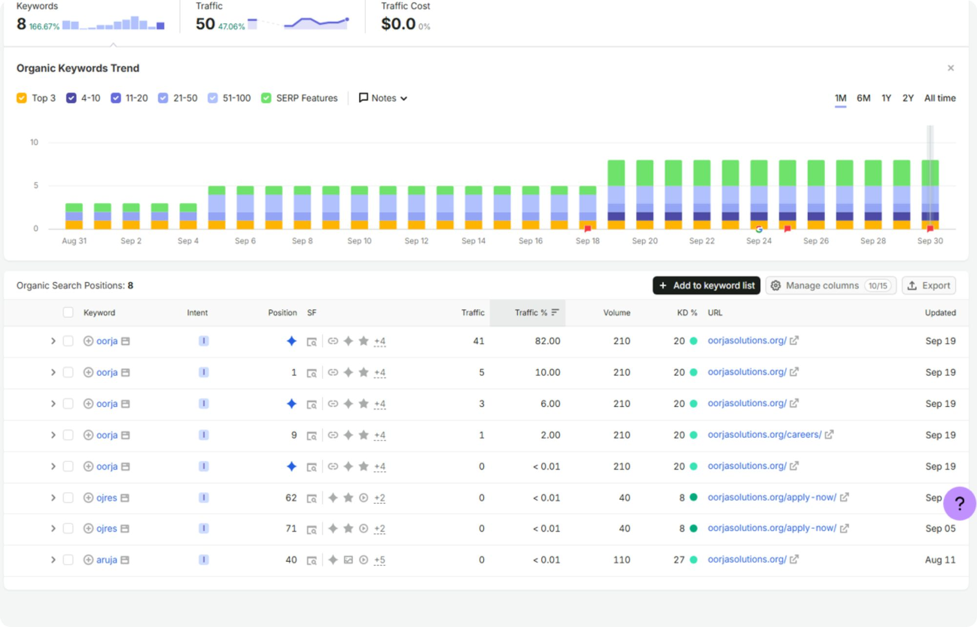
Insights
Organic keywords analysis
The main crisis
Ranks almost only for its own brand name and misspellings, so traffic value is $0.00.
Zero commercial keywords
Only “oorja” variants and typos (“ojres”, “aruja”); the brand drives 98% of traffic across 8 positions.
Keyword count doubling
Organic keywords grew from roughly 4 to 8 in September.
Position growth
Reached the Top 3 for the brand name in mid-September.
Please note, the data presented is subject to change over time due to evolving metrics such as performance fluctuations, strategic adjustments, and external market dynamics
Source: Semrush

Slide 21
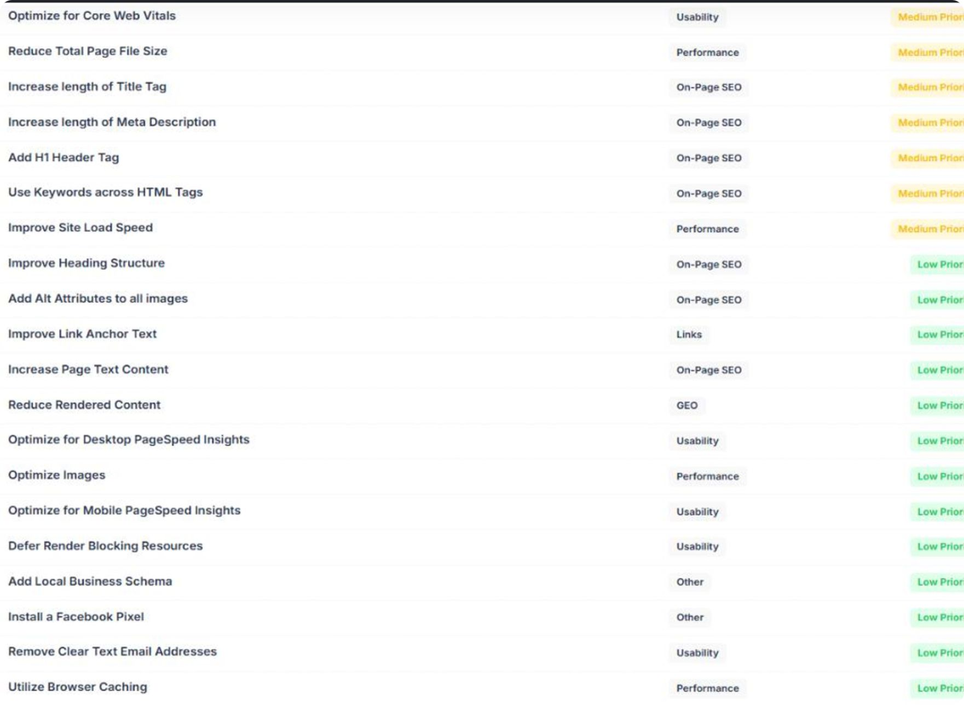
Insights
Improvement recommendations
Fix the meta tags
Lengthen the title tag and meta description and add an H1 using “solar irrigation” and “clean energy”.
Bridge the keyword gap
Use keywords across HTML tags to reinforce the keyword consistency report.
Attack the speed lag
Optimize Core Web Vitals, reduce page file size and improve load speed to lift the 57/100 score.
Low-priority housekeeping
Optimize images, add alt text, defer render-blocking resources, use browser caching, improve headings and add page text.
Please note, the data presented is subject to change over time due to evolving metrics such as performance fluctuations, strategic adjustments, and external market dynamics
Source: SEOPTIMER

Slide 22
Improvement recommendations: action plan
Fix the basics
Asset and image optimization
Advanced performance adjustments
Step 1: Fix the metadata
Title tag 50–60 characters with brand and main service. Meta description 150–160 characters with a clear call to action.
Step 1: Bulk-compress all site images
Step 1: Set up browser caching
Enable it on the server or hosting dashboard so returning visitors skip re-downloads.
Use a tool like TinyPNG or convert to WebP or AVIF; add a short descriptive alt text to every image.
Step 2: Re-architect headings
Step 2: Defer unnecessary scripts
Exactly one H1 with the primary keyword; clean H2/H3 hierarchy.
Step 2: Strip out unused media weight
Load third-party trackers like Facebook Pixel or Google Analytics asynchronously or with defer.
Step 3: Clean up vulnerabilities
Remove or compress hidden oversized graphics and heavy background video to cut total page file size.
Turn clear-text email addresses into a linked contact button or obscure them.
Step 3: Deploy local schema
Add a JSON-LD Local Business Schema to the page header so crawlers know where the business operates.

Slide 23
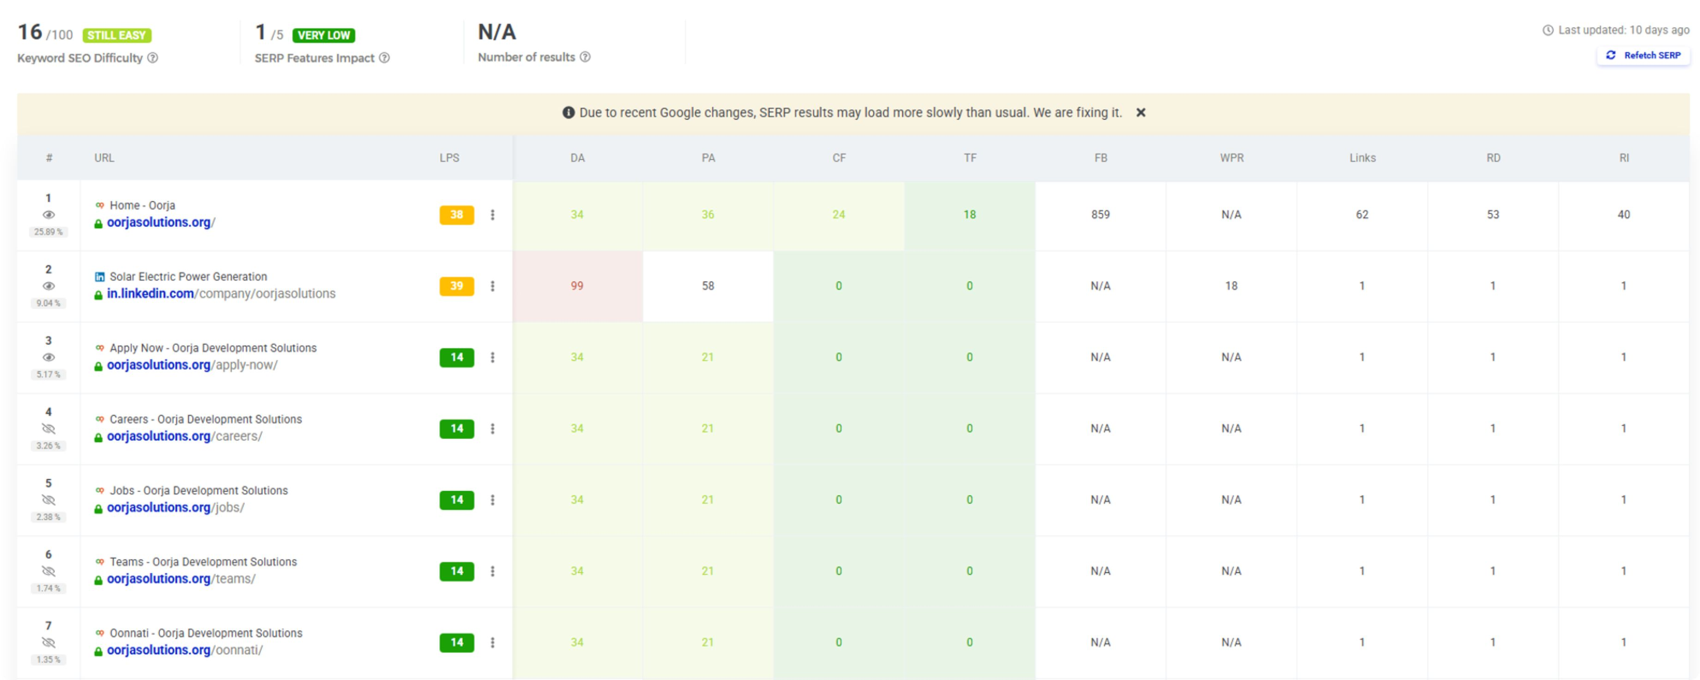
Website SERP analysis
Sources: Mangools

Slide 24
Website SERP analysis: insights
Insights
Page one is ours
Strength comes from the root domain
An easy keyword
Oorja Solutions dominates this search result, holding 6 of the top 7 organic positions alongside its official LinkedIn page.
Keyword difficulty is Still Easy (16/100), so the homepage authority is more than enough to crowd out competitors and secure the entire first page.
The homepage carries solid authority (38 Link Profile Strength), while internal pages like /careers/ and /jobs/ rank purely on the root domain's strength, with zero independent backlink authority.
Sources: Mangools

Slide 25
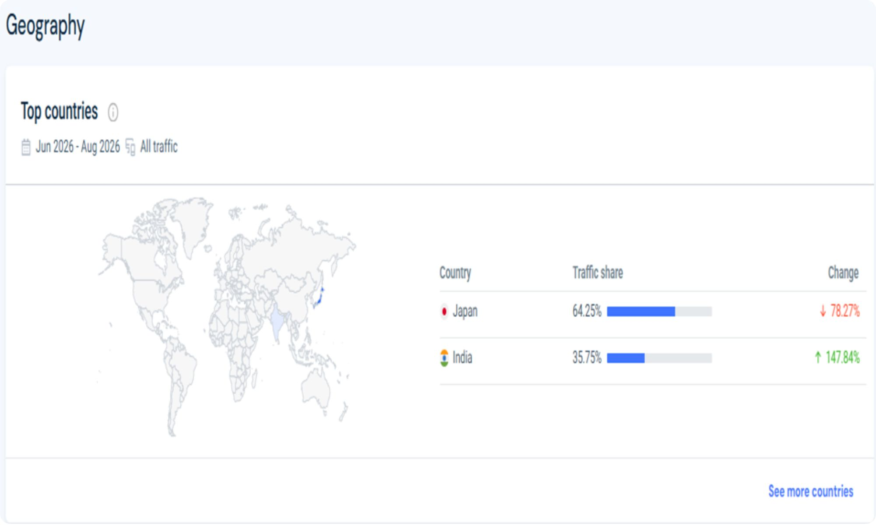
Insights
Website geo distribution analysis
Japan leads
The primary driver of traffic, with a dominant 64.25% share.
India is second
The secondary audience market, accounting for the remaining 35.75% share.
Major drop in Japan
Traffic from Japan plummeted 78.27%; still the largest source, but this decline needs immediate investigation.
Surge in India
Traffic from India is up 147.84%; momentum is shifting heavily toward this audience.
Please note, the data presented is subject to change over time due to evolving metrics such as performance fluctuations, strategic adjustments, and external market dynamics
Source: Similarweb
Notes:
Geo distribution: Japan holds 64.25% of traffic and India 35.75%. Japan fell 78.27% while India rose 147.84%.

Slide 26
SWOT analysis
Strengths INTERNAL
Weaknesses INTERNAL
Zero-CapEx B2C model — pay-per-use removes entry barriers
Integrated solutions — irrigation, milling and cooling in one ecosystem
High accountability — digital flowmeters build trust
Proven impact — verifiable carbon cuts, up to 87% diesel replacement
Capital intensive — high upfront rural solar investment
Slow payback — low-income micro-transactions
High logistical costs — remote field maintenance
Opportunities EXTERNAL
Threats EXTERNAL
Scope 3 decarbonization — partner with agri-corporations
Climate finance growth — carbon credits and philanthropy capital
FPO network aggregation — rapid community onboarding
Unpredictable subsidies — diesel or grid electricity support
Extreme weather — floods and storms
Volatile incomes — season-dependent farmer earnings

Slide 27
4 pillars of SEO
1
2
3
4
Relevant content production
Link acquisition strategy
UX & conversion design
Performance tracking & optimization
Streamline user flow and site navigation layout.
Boost page speed for better visitor retention.
Deploy responsive, mobile-first design elements.
Create informative, high-value material.
Integrate targeted keyword terms naturally.
Refresh text regularly to maintain accuracy.
Build backlinks from authoritative sources.
Target industry partners for contextually relevant connections.
Maintain a natural and diversified backlink profile.
Monitor and segment all inbound traffic channels.
Analyse user behaviour patterns for experience enhancement.
Optimise structural funnels to improve conversion rates.
Organic growth

Slide 28

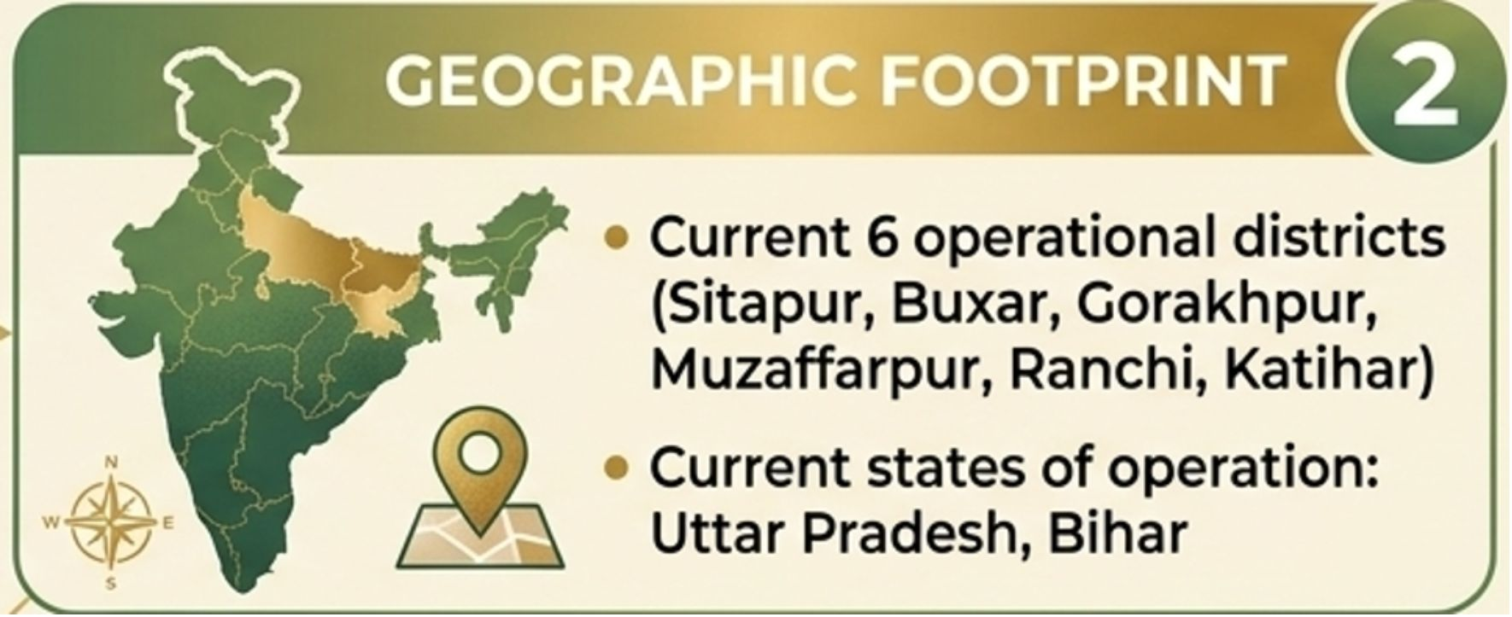
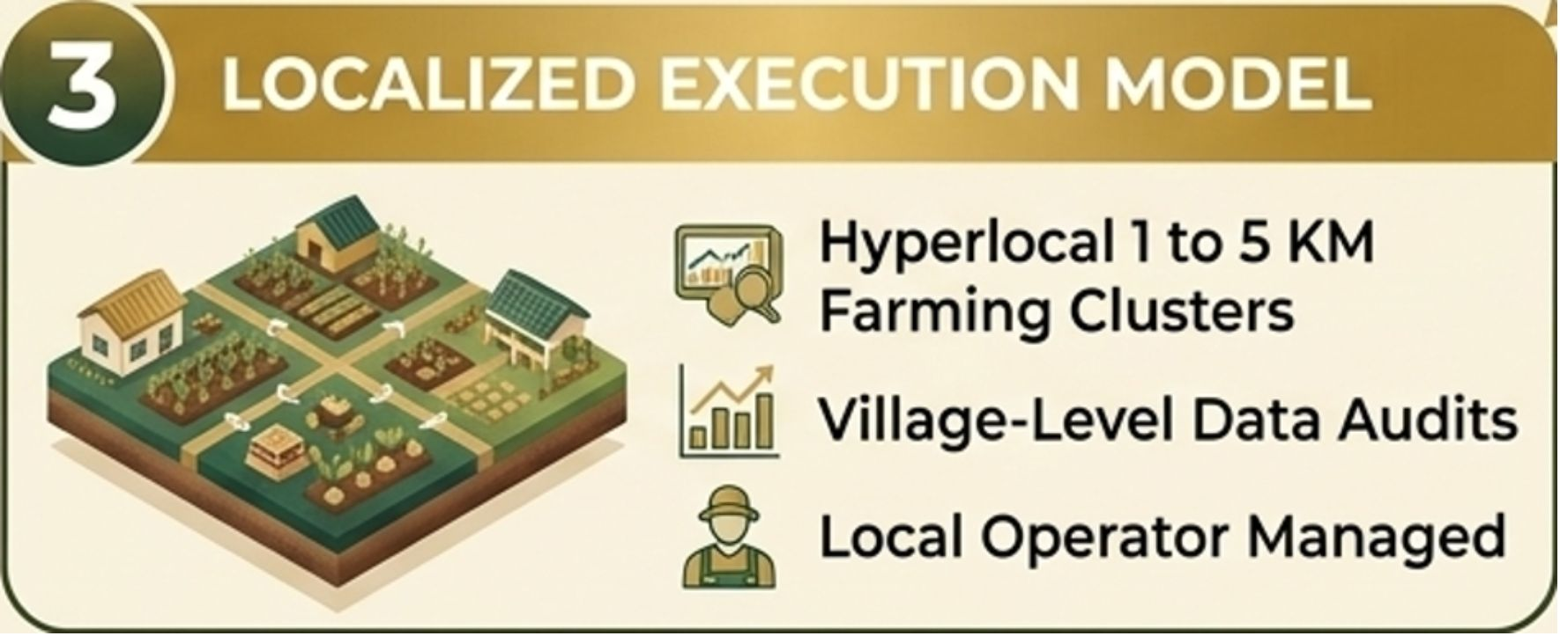
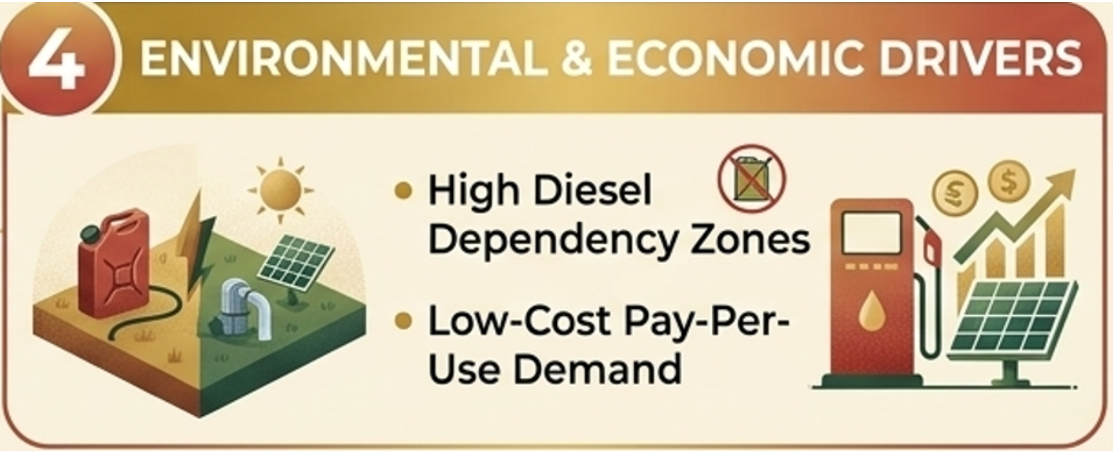
Target location
Oorja's target market strategy

Slide 29
Target location expansion strategy
Core categories
What Oorja is doing
What Oorja can improve
Expansion strategy
Hyperlocal cluster scaling: focuses on high-friction, diesel-dependent zones in 6 districts across Uttar Pradesh and Bihar.
Geographic diversification: expand beyond the Northern/Eastern belt into high-yield, sunny zones like Central or Western India.
Service integration
Dual utility bundling: shared solar irrigation pumps (Oonnati) paired with climate-smart advisory (Oorvar).
Post-harvest cold chain: scale decentralized, farm-gate solar cold storage to protect crops from distress-selling.
Resource management
Volumetric monitoring: manual inline flowmeters on pumps bill by water volume and curb groundwater draw.
IoT automation and predictive audits: upgrade to automated IoT smart grids with satellite remote sensing to track crop health.
Community structure
Hub-and-spoke hiring: groups smallholder cohorts within a 1-5 km radius and employs local villagers to run daily operations.
Institutional scale via FPOs: partner directly with Farmer Producer Organisations to accelerate trust and deployment.

Slide 30
Target audience
Farmers owning small plots (often <2 hectares).
Lower to middle income.
Often in rain-fed areas or semi-irrigated land.
Primarily in UP, Maharashtra, and similar states; expansion states in future.
Small & marginal farmers
Young people in rural communities, often women, or young men.
Some agricultural background or willingness to learn.
Interested in extra income / business opportunity.
Trusted in their communities.
Village-level entrepreneurs / peer partners
Homemakers who help with farm activities.
Women involved in peer commerce / input procurement in household.
Youth looking for non-migrant opportunities or supplemental income.
Women & rural youth

Slide 31
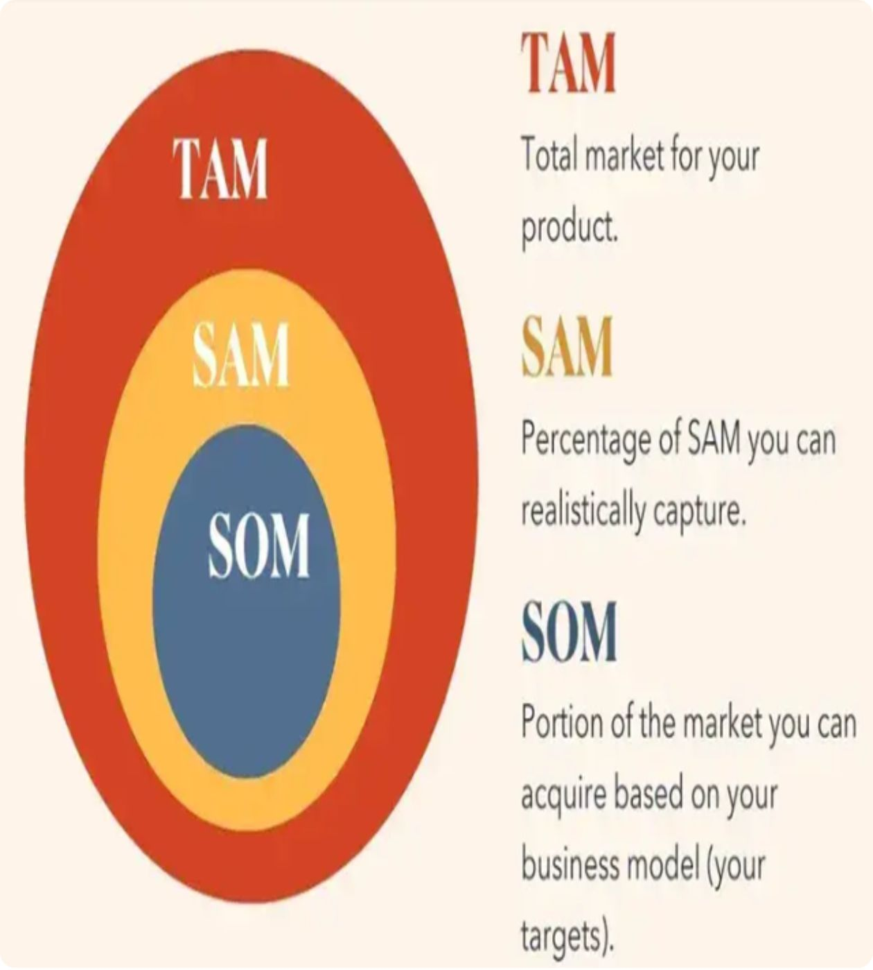
Total addressable market funnel
The market sizing framework
TAM (Total Addressable Market): The ultimate revenue ceiling: total global or national demand for a product or service at 100% market share.
SAM (Serviceable Addressable Market): The slice of the TAM within geographical reach and logistically targetable by the current core offering.
SOM (Serviceable Obtainable Market): The realistic, short-term share a business can actually capture given its resources, competition and sales channels.
Source: solve.mit.edu/solutions/83445
Source: World Bank & GOGLA Off-Grid Solar Market Trends Reports

Slide 32
Total addressable market funnel
Total addressable market (TAM)
Serviceable available market (SAM)
USD 18-22 billion
USD 1.5-3 billion
(₹1,50,000 - 1,85,000 crore) per annum
(₹12,500 - 25,000 crore) per annum
Core parameters: Collective spend of India's small and marginal farmers on localized irrigation (diesel replacement), agro-processing services and climate-smart advisory.
Scope: Maximum revenue opportunity if 100% of India's smallholder and marginal farming households permanently switched to a Pay-Per-Use agrivoltaic and service model.
Core parameters: Reflects operational logistics, target state selection (high-irradiance, diesel-dependent zones like Uttar Pradesh and Bihar) and last-mile village cluster limits.
Scope: The portion where Oorja can effectively deploy its 1 to 5 KM hub-and-spoke infrastructure across its primary scaling corridors.
Source: solve.mit.edu/solutions/83445
Source: World Bank & GOGLA Off-Grid Solar Market Trends Reports

Slide 33
Total addressable market funnel
Serviceable obtainable market (SOM)
Market context
USD 15-50 million
Diesel replacement market: a multi-billion dollar opportunity for smallholder and marginal farmers in India, driven by structural shifts away from fossil fuels; customers save directly on diesel costs.
(≈ ₹125-420 crore) in 3-5 years
With systematic cluster scaling: deploying agrivoltaic assets, recruiting field operators, building local trust and expanding digital agronomy.
Target: capture roughly 1-2% of the near-term SAM across targeted rural blocks.
Aligns with the goal to multiply active projects beyond the initial 389 solar pumps deployed.
Clean energy transition demand: 87% of customers no longer use diesel after adopting Pay-Per-Use; 402 projects installed, impacting 73,448+ smallholders and family members, with a 33% average increase in household agricultural revenue.
Source: solve.mit.edu/solutions/83445
Source: World Bank & GOGLA Off-Grid Solar Market Trends Reports

Slide 34
Micro funnel breakdown
Metric
Example scenario
Numbers / assumptions
Oorja expands into high diesel-reliance clusters in key northern/eastern states, where ~5 million smallholder and marginal farmers need affordable irrigation.
Total farmers in target states
5 million farmers
Reachable audience via field networks + digital
Community demos, local operator networks and digital outreach let Oorja reach 20% of these underserved farmers.
1 million farmers
Assuming a 5% adoption rate, reachable farmers onboard onto the Oonnati Pay-Per-Use solar pumping network during primary cropping seasons.
50,000 active users
Conversion rate (Pay-Per-Use signup)
Based on average seasonal solar water-delivery usage fees per farmer on typical small plots.
USD ~50
Avg order value (AOV) per season
(approx. ₹4,200)

Slide 35
Competitor analysis
Market reach
Brand perception
Extremely strong footprint across 14 states in India, with heavy operational presence in high-power-deficit, agrarian regions like Bihar and Uttar Pradesh. Benefited over 100,000 individuals through fixed installations and portable solar trolley networks.
Widely recognized as an established, pioneering institutional solar pumping brand backed by significant venture capital (SIDBI Venture Capital). Perceived by farmer collectives as a reliable provider of both grid-tied hardware and micro-irrigation solutions.
Competitor
Claro Energy
Target keywords
Key strength
Key weakness
Competes aggressively on high-intent agricultural utility keywords including solar water pump subsidy, portable solar trolley irrigation, AC/DC solar pump prices, and government solar pump schemes (KUSUM).
Massive operational scale and hardware flexibility, with a portfolio from 0.5 HP to 10 HP surface and submersible pumps. Strong infrastructure backing lets them service large-scale drinking water and fisheries projects alongside crop irrigation.
High dependency on institutional and government-tied vendor contracts. Their on-demand retail model relying on tractor-towed rental trollies adds higher operational overhead and logistical friction versus localized cluster-based fixed asset deployment.

Slide 36
Competitor analysis
Competitor
Market reach
Brand perception
Ecozen Solutions
Massive operational footprint with over 400,000+ installations across India. Highly prominent in cold-chain logistics (Ecofrost) and smart irrigation controllers (Ecotron), working closely with state governments and corporate agriculture.
An established, premium deep-tech and IoT-driven agritech giant. Perceived as a highly sophisticated technology provider that optimizes water delivery using predictive data, remote monitoring and advanced solar analytics rather than just hardware setup.
Target keywords
Key strength
Key weakness
Competes heavily on keywords surrounding smart solar pumping controllers, IoT irrigation monitoring, solar micro-cold storage, and PM Surya Ghar Yojana vendor network.
Advanced IoT and diagnostics stack. Their pumps use predictive analytics to anticipate maintenance needs and optimize water yield. Strong institutional backing and deep penetration into the commercial B2B agritech supply chain.
Focuses primarily on asset ownership and technology deployment rather than purely decentralized, local community retail models. Their capital-intensive hardware solutions require substantial up-front subsidies or enterprise financing, making direct adoption friction-filled for completely unbanked smallholders.

Slide 37
Competitor analysis
Competitor
Market reach
Brand perception
AgriVijay
Rapidly expanding marketplace model functioning as India's premier curated platform for renewable energy in agriculture. Operates through physical "AgriVijay Village Franchise" networks that bring multi-brand green energy tools directly to farm gates.
Perceived as a farmer-centric, one-stop e-commerce and aggregation hub for climate-smart infrastructure. Known for making clean-tech affordable by offering choice, rather than tying farmers to a single brand's technology.
Target keywords
Key strength
Key weakness
Aggressively captures traffic for buy solar water pump online, biogas digester price, solar agricultural tools marketplace, and farm-level renewable energy franchise.
Aggregated asset portfolio. Instead of building proprietary pumps, they retail equipment from various top manufacturers, allowing flexible horsepower solutions (1 HP to 10 HP) bundled with financial credit options and end-to-end installation services.
Lacks a unified "pay-per-use" localized asset service model like Oorja's flagship framework. Because they primarily drive asset sales, the barrier to entry remains reliant on the smallholder's capability to take on a loan or purchase the asset outright.

Slide 38
Competitor analysis
Competitor
Market reach
Brand perception
Khethworks
Strategic hyper-local focus targeting smallholder and marginal farmers across eastern India (primarily West Bengal, Odisha, and Bihar). Built to optimize micro-plots where traditional, massive solar systems are non-viable.
Recognized as a specialized, highly efficient hardware innovator born out of MIT research. Perceived as an empathetic engineering brand that builds lightweight, ultra-portable systems tailored precisely for the regional geography of fragmented land plots.
Target keywords
Key strength
Key weakness
Ranks for portable solar pumps for small farmers, lightweight solar irrigation, affordable openwell solar pumps, and smallholder year-round cultivation.
Unmatched portability and low-voltage efficiency. Their flagship pumps are light enough to be carried by hand to field boundaries and can run off small, flexible solar arrays, bypassing the need for heavy stationary structures or tractor towing.
Limited product diversification and lower market footprint compared to diversified clean-tech giants. They focus squarely on localized, small-scale surface water pumping, leaving a gap in deep groundwater extraction or large-scale community distribution infrastructures.

Slide 39
Section
Keyword research, clustering & mapping

Slide 40
Keyword research
solar irrigation system
solar powered irrigation
solar water pump for agriculture
solar powered irrigation system
solar pump for agriculture
solar power pump for agriculture
sustainable agriculture
Agriculture
renewable energy sources
renewable energy
green energy
solar power
solar energy systems
renewable energy systems
solar powered pumps
agriculture farming
agriculture project
solar

Slide 41
Keyword research: informational
Keyword
Search volume
Competition
Agriculture
500k
Low
Sustainable agriculture
50k
Low
Renewable energy
50k
Low
Green energy
50k
Low
Solar power
50k
Low
Agriculture farming
50k
Low

Slide 42
Keyword research: commercial
Keyword
Search volume
Competition
Solar irrigation system
5K
Low
Solar powered irrigation
5K
Low
Solar powered irrigation system
5K
Low
Solar energy systems
5K
Low
Renewable energy systems
50K
Low
Solar powered pumps
50K
Medium

Slide 43
Keyword research: transactional
Keyword
Search volume
Competition
Solar water pump for agriculture
5K
Medium
Solar pump for agriculture
5K
Medium
Solar power pump for agriculture
5K
Medium
Solar service
5K
Low
Solar panel cleaning service
5K
Low
Solar panel
5K
Low

Slide 44
Keyword research: navigational
Keyword
Search volume
Competition
Oorja solutions
50
Low
Oorja development solutions limited
50
Low
Oorja portal login
500
Low

Slide 45
Keyword mapping
Homepage keyword mapping
Solution pages keyword mapping
Renewable energy
Solar energy systems
Solar irrigation system
Green energy
Solar powered irrigation
Solar powered irrigation system
Solar power
Solar powered pumps
Solar water pump for agriculture
Sustainable agriculture
Renewable energy systems
Solar pump for agriculture
Solar power pump for agriculture
NOTES:
Mapped keywords based on search intent and page relevance.
Broad commercial/informational keywords were targeted on the Homepage.
Specific commercial/transactional keywords were mapped to Solution pages.
This improves relevance and reduces keyword cannibalisation.

Slide 46
Keyword mapping
Blog page keyword mapping
Sustainable agriculture
Agriculture
Renewable energy
Green energy
Renewable energy systems
Solar power
Agriculture farming
Solar energy systems
NOTES:
Keywords were segregated based on informational intent and user education.
We targeted high-volume industry terms on the Blog page to attract top-of-funnel users.
Broad sector pillar keywords were mapped here to build topical authority.
This improves resource credibility and captures informational search traffic naturally.

Slide 47
Keyword cluster
Cluster name
Primary keywords
Secondary keywords
Agriculture & farming
Agriculture
Agriculture farming, Small scale farming, Agriculture project
Sustainable agriculture
Sustainable farming practices, Sustainable agriculture practices, Green agriculture
Sustainable agriculture
Smart farming system, Smart farming technologies, Climate smart agriculture practices, Innovation in agriculture
Smart agriculture
Smart agriculture
Renewable energy sources, Renewable energy technologies, Renewable energy projects, Renewable energy world, New renewable energy sources
Renewable energy
Renewable energy

Slide 48
Blog optimization
Meta title
56 characters
Solar Water Pump for Agriculture & Irrigation Systems
Meta description
152 characters
Discover how a solar irrigation system cuts diesel costs. Explore top-rated solar powered pumps built for sustainable agriculture farming projects.
H1 headline
Solar Powered Irrigation Systems for Modern Agriculture
Focus keywords
solar irrigation system
solar water pump for agriculture
solar powered pumps

Slide 49
Digital strategy roadmap
6-month roadmap for Oorja Development Solutions
Months 1-2
Months 3-4
Months 5-6
SEO optimisation
Google Search Ads for business partners
Meta Ads (Facebook/Instagram) with local language targeting for rural farming communities
Remarketing campaigns for website visitors
Educational blogs on climate-smart farming
Farmer success stories on social media
Partnerships with agri-YouTubers and farmer WhatsApp groups
WhatsApp and SMS automation for water scheduling updates
Expanded budgets for major institutional partnerships
Ties with local NGOs and agri-retailers to grow the community network
›
›

Slide 50
Blog content for SEO
1
2
3
Use local language keywords
Create FAQ-rich posts
Add internal links from blogs to service pages
Hindi + regional terms connect naturally with ground-level farming communities searching for affordable irrigation.
Helps with Google's featured snippets by answering operational questions about solar system maintenance and solar tariffs.
Boosts conversions by guiding readers from educational pieces to sign-up forms for Oonnati (Irrigation-as-a-Service) or Oorvar (Climate-Smart Advisory).
4
5
Focus on long-tail keywords
Optimize for voice search
e.g., best solar water pump for agriculture in Uttar Pradesh, to capture high-intent geographic searches from target regional clusters.
Farmers often use Google Assistant in Hindi/regional languages; capture spoken queries like "solar pump pricing" or "how to clean solar panels".

Slide 51
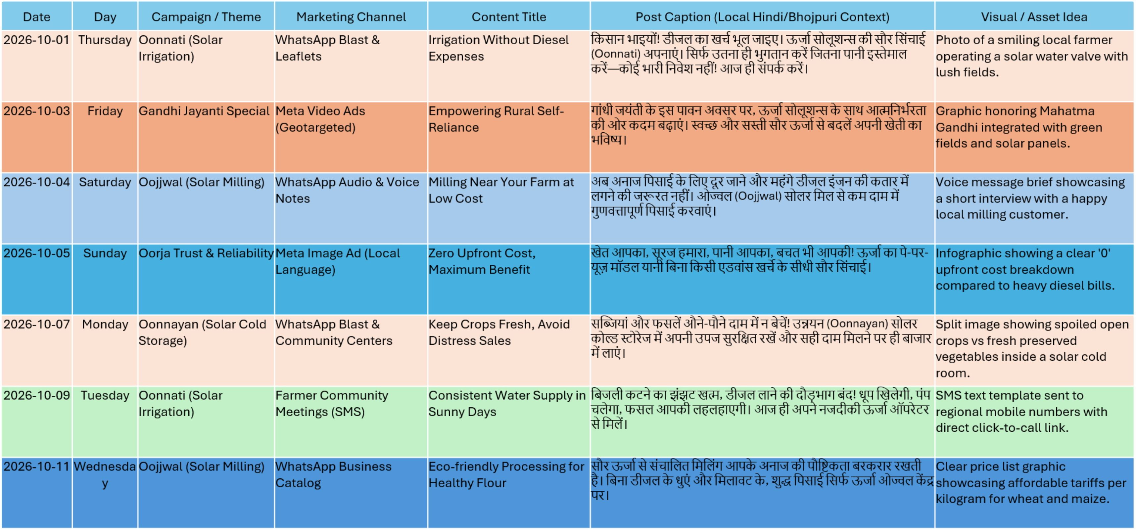
Social media calendar: October

Slide 52
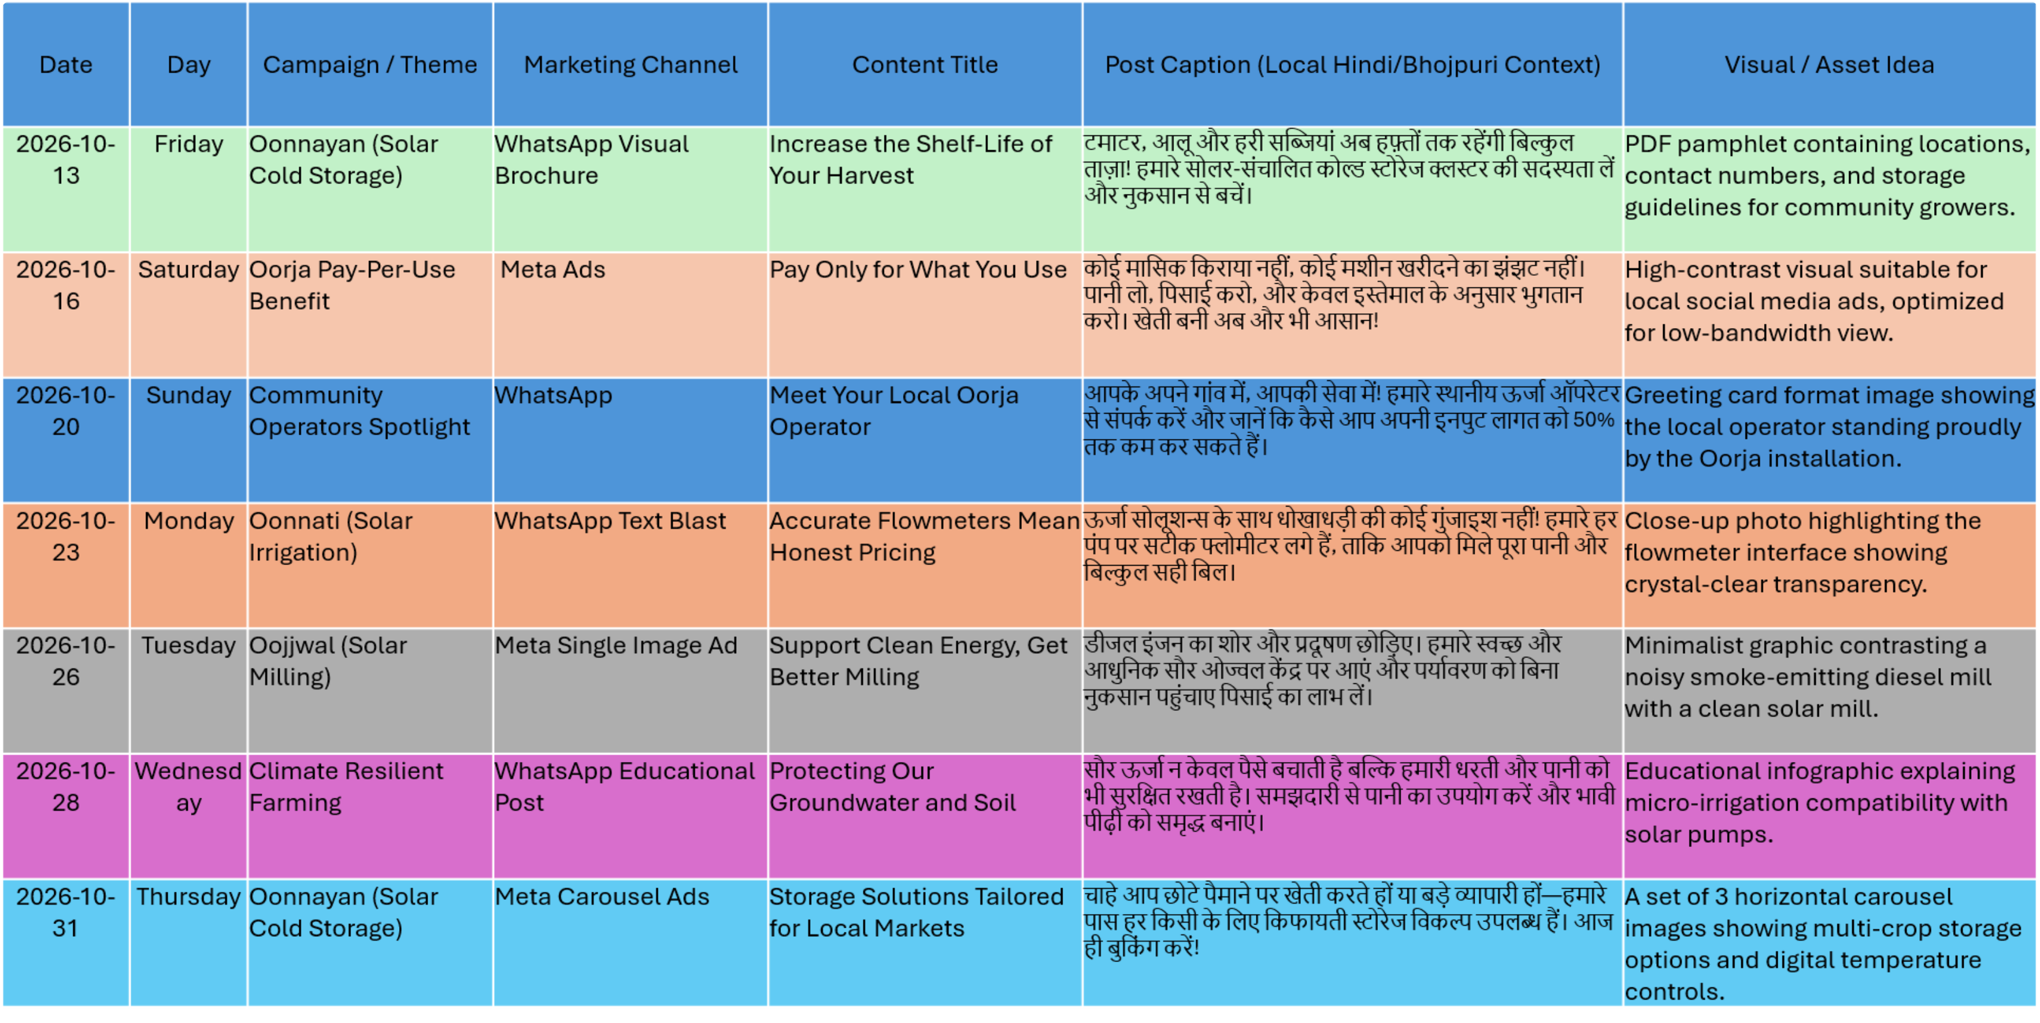
Social media calendar: October (continued)

Slide 53
Section
PPC part analysis

Slide 54
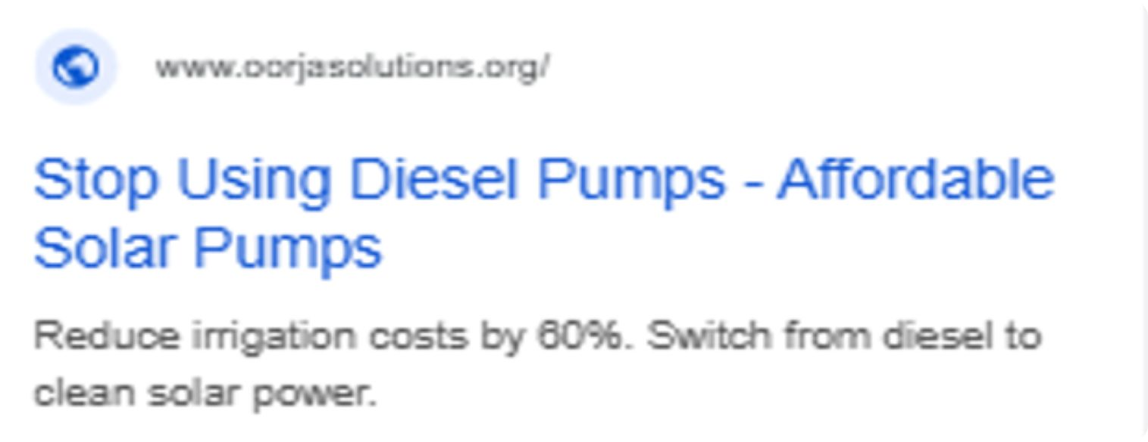
Google Search Ads campaign
Campaign
Ad group 1
Campaign name: OORJA Search Ad Campaign-Leads
Bidding strategy: Clicks
Headline 1: Affordable Solar Pumps 22/30 characters
Headline 2: Stop Using Diesel Pumps 21/30 characters
Description: Reduce irrigation costs by 60%. Switch from diesel to clean solar power 71/90 characters
Campaign settings
Location: India
Ad schedule: 8:00 am, 10:00 pm (farmer's active hours)
Language: All languages
Audience: Business professionals, Green living enthusiasts
Targeting setting: Observation (don't narrow the reach of your campaign, with the option to adjust the bids on the selected segments)
Ad rotation: Optimised
Ad preview

Slide 55
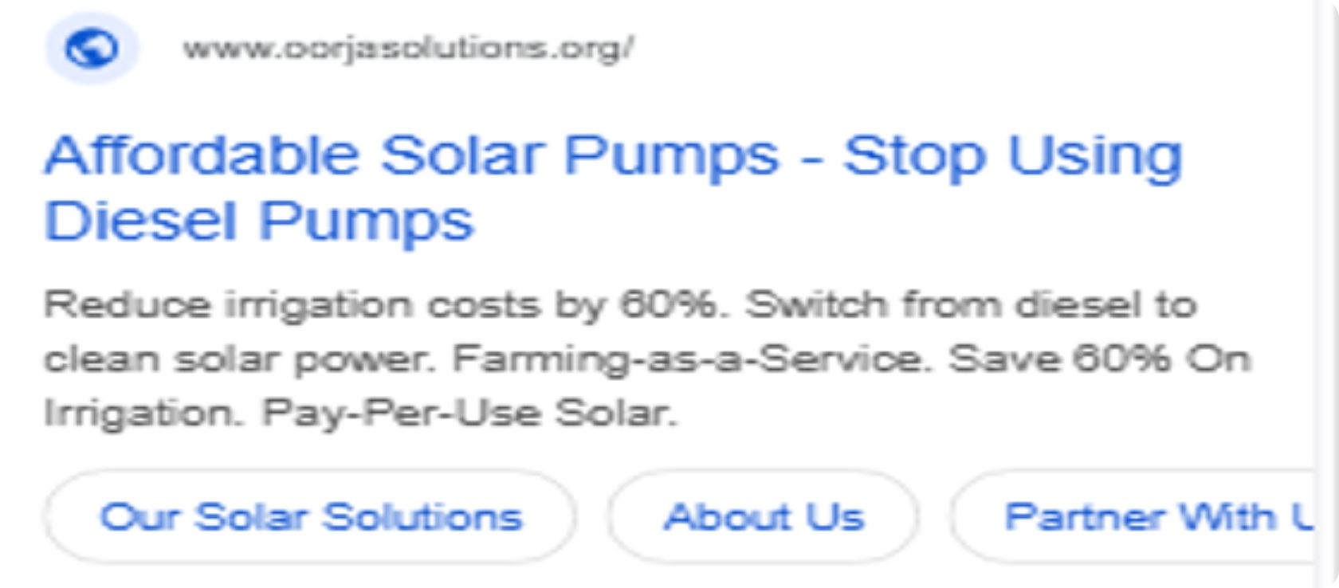
Google Search Ads campaign: ad extensions
Ad preview
Site links
Our solar solutions
Partner with us
About us
Call-outs
Save 60% on irrigation
Farming-as-a-service
Pay-per-use Solar
Structured snippets
Pay-Per-Use Models
Community Solar Hubs
Climate-Smart Agri

Slide 56
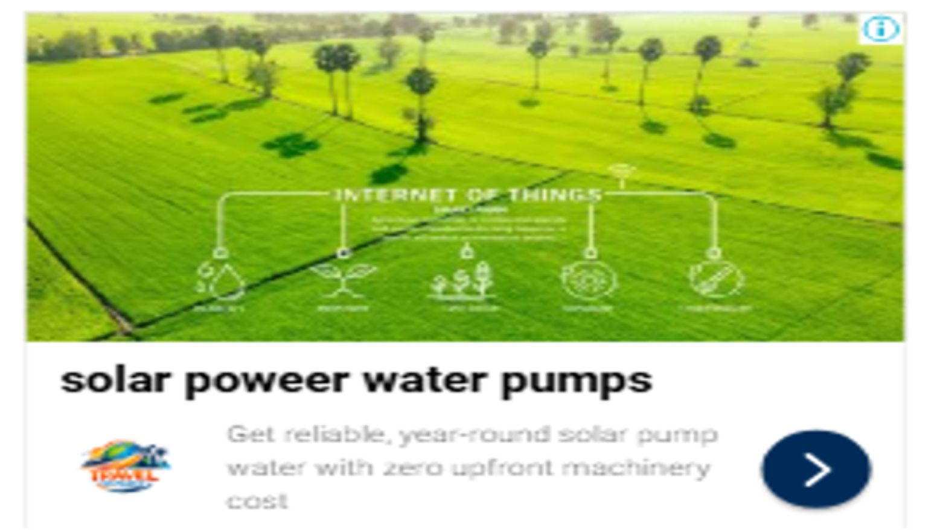
Google Display Ads campaign
Ad preview
Campaign
Campaign name: OORJ SOLUTIONS Display ad
Bidding strategy: Maximise Conversions
Location: India
Targeting
Demographic: 18-65 years old
Ad schedule: 8:00 am, 10:00 pm (farmer's active hours)
Language: All languages
Audience: Solar Energy, Solar Power, Agriculture Technology

Slide 57
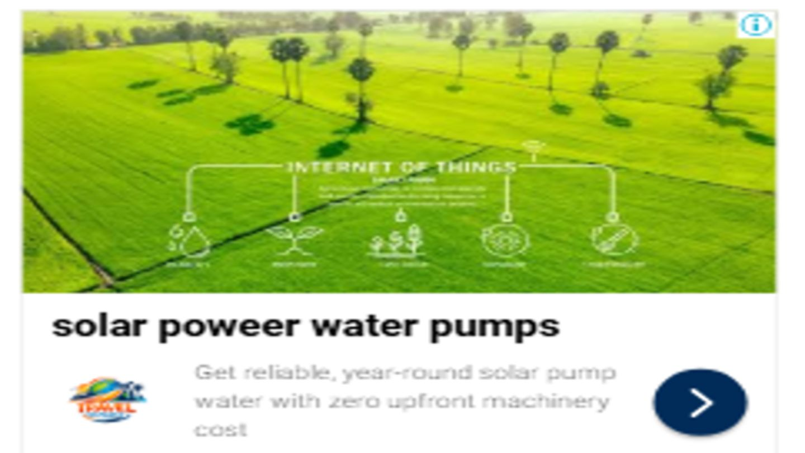
Google Display Ads campaign: ad creation
Ad preview
Targeting
Placements: Agriculture blogs, YouTube Channels
Ads creation
URL: https://oorjasolutions.org
Ad format: Responsive Display Ads (image, logo, text)
Headline 1: Oorja Development Solutions
Headline 2: Solar power water pumps
Long headline: Boost your crop yield and farm revenue with affordable Pay-Per-Use irrigation.
Description: Get reliable, year-round solar pump water with zero upfront machinery cost
Call to action: Contact-us

Slide 58
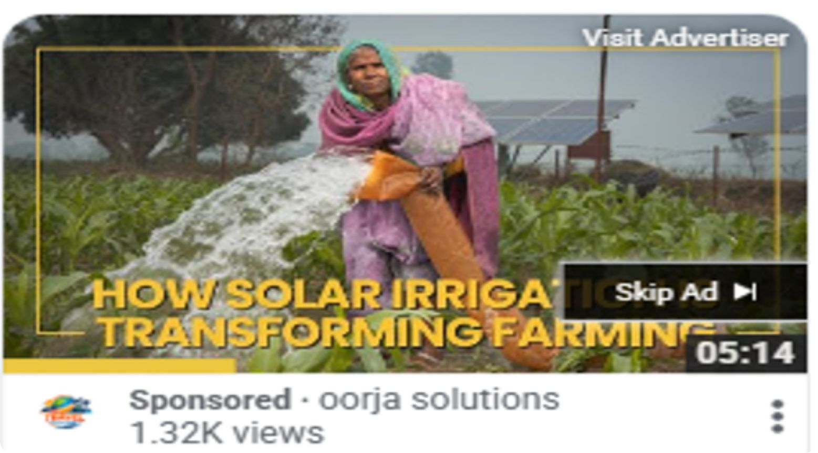
Google Video Ads campaign
Ad preview
Campaign
Campaign name: oorja solutions video ads
Ad formats: Skippable in-stream ads, in-feed ads, short ads (it will help in 40% more views)
Bid strategy: Target CPV
Budget, dates & targeting
Campaign total budget: 7000
Dates: 5th Oct 2026, ends in 2 weeks
Networks: YouTube
Location: India
Languages: All languages

Slide 59

Google Video Ads campaign: ad group
Ad preview
Ad group
Ad group name: OORJa SOLUTIONS demonstration video
Audience demographics: 18-65
Audience interest: Farms, Farming, Agricultural service for food crops
Video ads
Long headline: Cut your irrigation costs by 60% with affordable solar power services. 71/90 characters
Description: Get reliable, year-round water for your crops with zero upfront costs. 69/90 characters
Bid
1.00 Target CPV

Slide 60
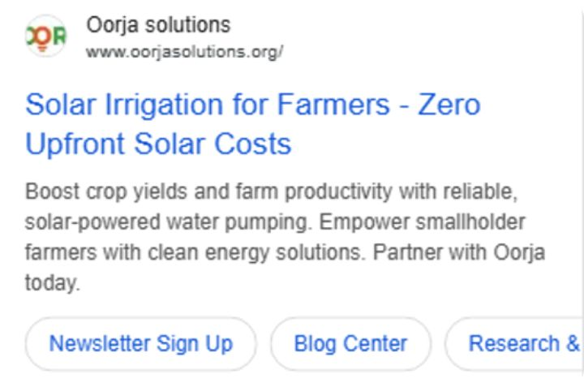
Google Performance Max campaign
Campaign
Campaign name: oorja solutions Performance Max
Bidding: Maximize Conversions
Location: India
Languages: All
Devices: Computer, Mobile, Tablets
Ad preview
Ad assets
Headline 1: Solar Powered Water Pumping
Headline 2: Cut Irrigation Costs by 60%
Description 1: Cut Irrigation Costs By Up To 60% With Oorja's Pay-Per-Use Solar Farming Services Today
Description 2: Eliminate Diesel Reliance & Save Big On Pumping - Switch To Clean Solar Energy Now
Site link 1: Technology Solutions
Site link 2: Case Studies
Call to action: Contact Us
Search themes
Agriculture Water Pump
Solar Pump
Irrigation water Pump

Slide 61
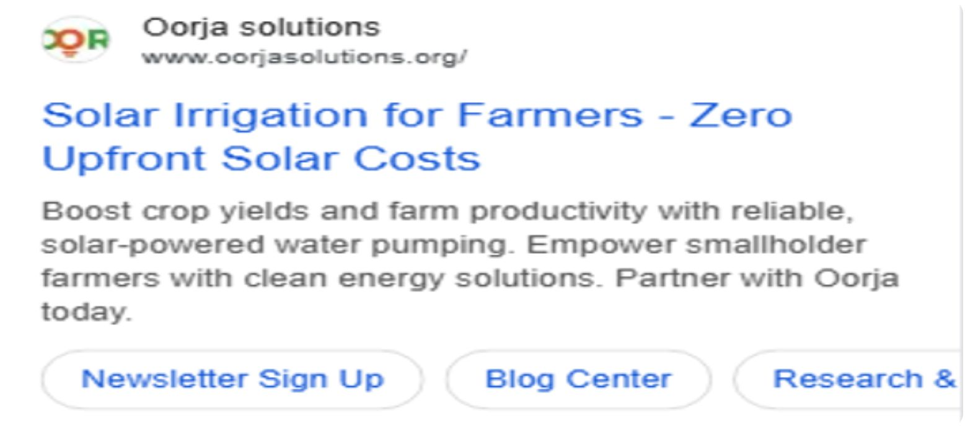
Google Performance Max campaign: signals and budget
Ad preview
Signals
Search themes
Agriculture Water Pump
Solar Pump
Irrigation water Pump
Audience: Demographics All
Site links: Technology Solutions, Case Studies | Call to action: Contact Us
Budget
20000
Campaign total budget

Slide 62

Meta Awareness Ads campaign
Campaign
Campaign name: OORJA SOLUTIONS Awareness campaign
Buying type: Auction
Objective: Awareness
Bid strategy: Highest Volume
Ad preview
Budget & schedule
Budget strategy: Campaign Budget
Daily budget: 200
Budget scheduling: Start 6th Oct 2026, end 20th Oct 2026
Campaign frequency: 2 times in 7 days
Ad set
Ad set name: OORJA SOLUTIONS Awareness ad set
Performance goal: Maximise reach of ads
Notes:
Meta Awareness campaign setup: objective Awareness, auction buying, highest volume bidding, budget 200 daily from 6 to 20 October 2026.

Slide 63

Meta Awareness Ads campaign: ad details
Ad
Ad preview
Ad name: OORJA SOLUTIONS Awarness ad
Ad setup: Single image
Headline: Empowering low-income smallholder farmers with sustainable agritech.
Description: Get reliable, year-round water for your crops with zero upfront costs.
Link & call to action
Website URL: https://oorjasolutions.org
Display link: oorjasolutions.org
Call to action: Contact Us
Tracking: UTM parameters
utm_source=Facebook&utm_medium=paid_social&utm_campaign=OORJA+SOLUTIONS+Awarness+campaign&utm_content=OORJA+SOLUTIONS+Description

Slide 64
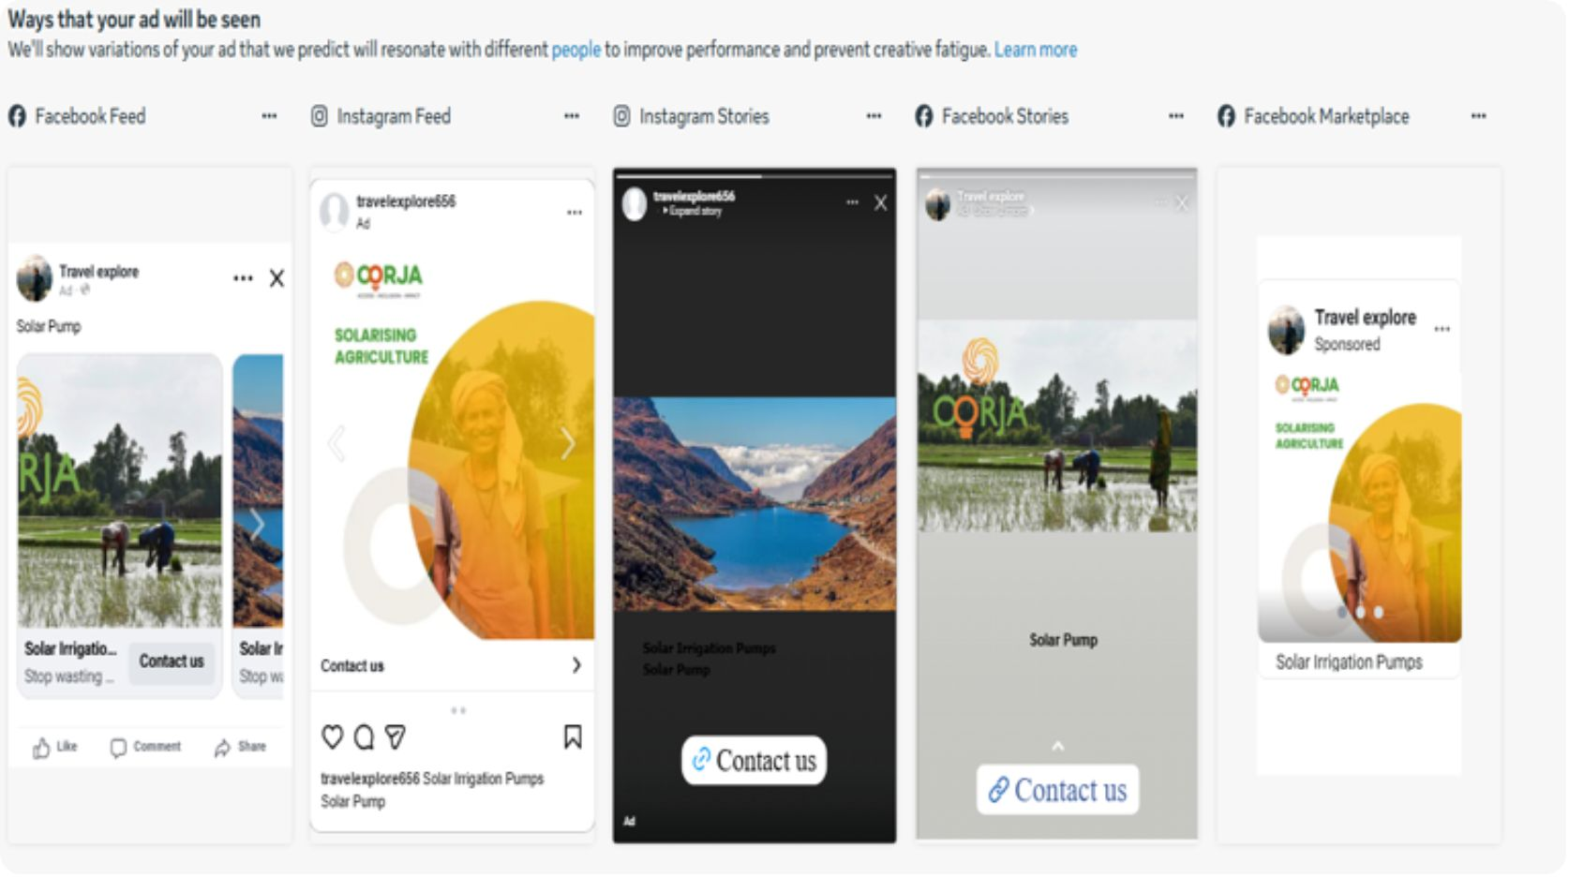
Meta Leads ad
Campaign
Ad placements preview
Campaign name: OORJA SOLUTIONS NEW LEADS
Buying type: Auction
Objective: Leads
Budget: Campaign Budget
Budget strategy: Life Time
Ad scheduling: Run ads on schedule time
Ad set
Ad set name: Oorja solutions new leads ad set
Conversion: Website and call
Performance goal: Maximise number of conversions
Dynamic creative: On
Placements: Automatic
FACEBOOK FEED
INSTAGRAM FEED
STORIES & MARKETPLACE

Slide 65
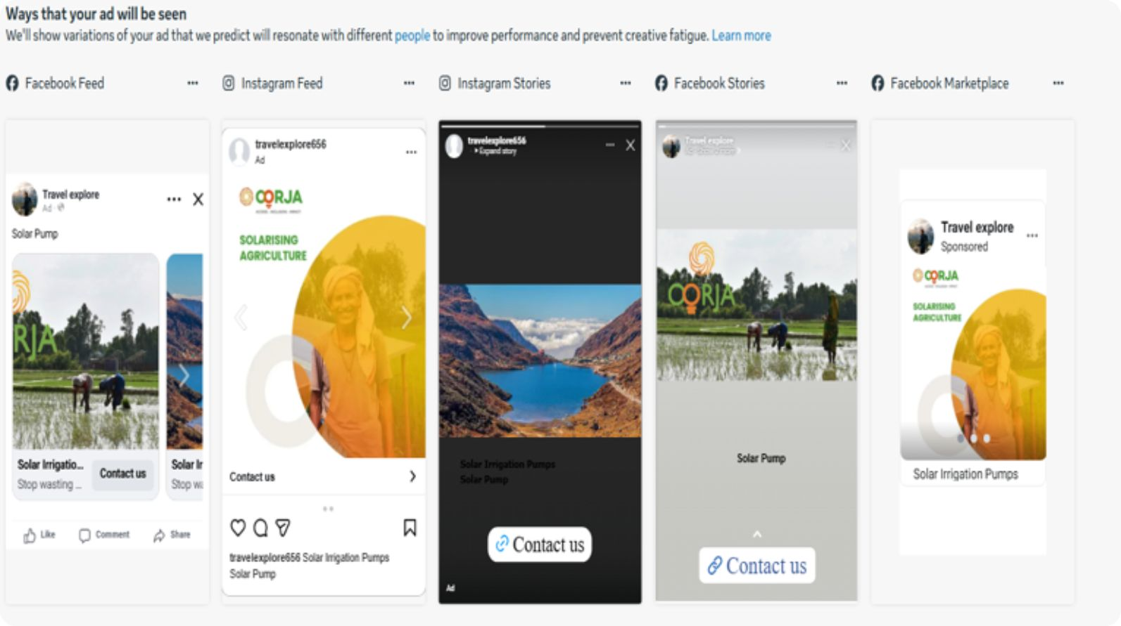
Meta Leads ad: ad details
Ad
Ad placements preview
Ad name: OORJA SOLUTIOS New Leads ad
Headline: Solar Irrigation Pumps
Description: Stop wasting money on expensive diesel. Switch to Oorja's reliable solar irrigation systems with zero upfront costs. Pay only for the water you use via transparent digital flowmeters and boost your crop yields sustainably!
Ad set settings
Conversion: Website and call
Performance goal: Maximise number of conversions
Dynamic creative: On
Placements: Automatic
Tracking: UTM parameters
utm_source=Facebook&utm_medium=cpl_leadform&utm_campaign=OORJA+SOLUTIOS+New+Leads+ad&utm_content=oorja+leads

Slide 66
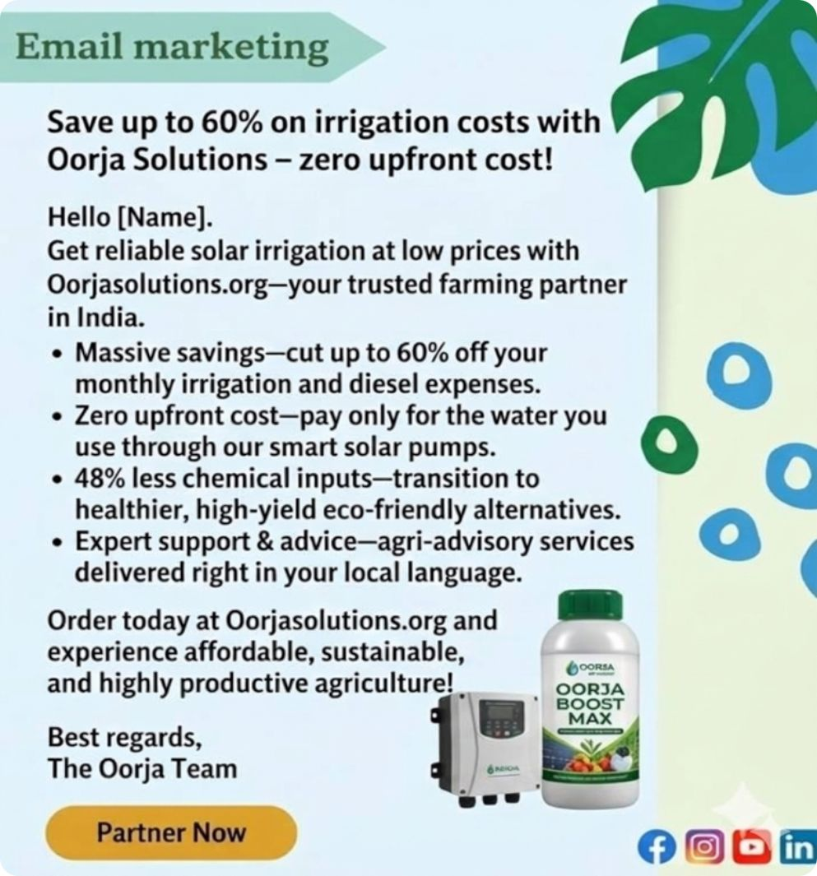

Email marketing
Subject line: Save up to 60% on irrigation costs with Oorja Solutions – zero upfront cost!
Email design
Email body
Hello [Name],
Get reliable, year-round solar irrigation and climate-smart advisory with Oorjasolutions.org, your trusted farming partner in India.
Massive savings: up to 60% off irrigation and diesel costs.
Zero upfront cost: pay only for the water you use.
48% less chemical inputs: healthier, high-yield, eco-friendly.
Expert support: agri-advice in your local language.
Call to action
Order today at Oorjasolutions.org for affordable, sustainable, productive agriculture!
Best regards, The Oorja Team

Slide 67
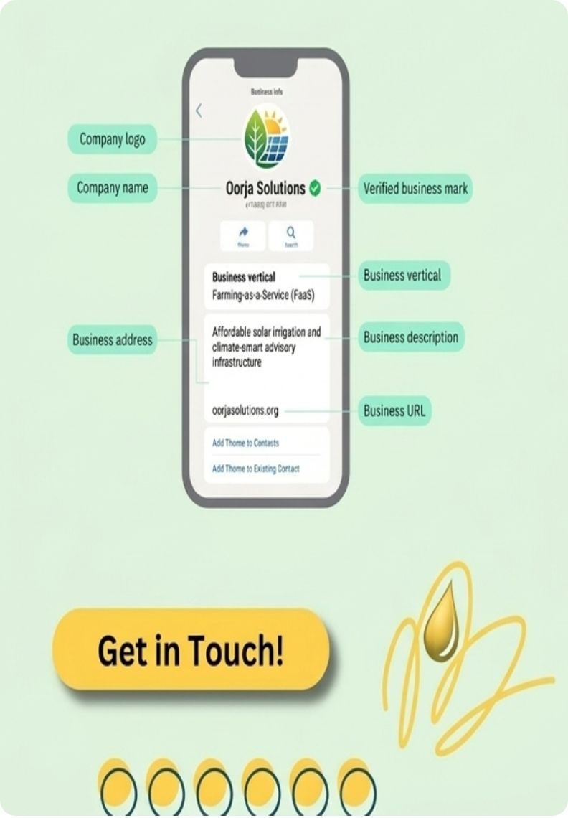
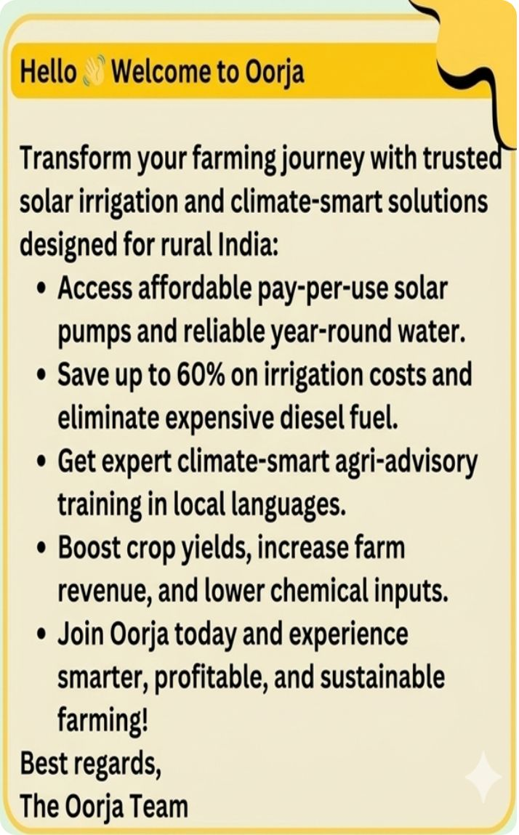
WhatsApp marketing
Business profile
Message design
Welcome message
Hello Welcome to Oorja
Transform your farming journey with trusted solar irrigation and climate-smart solutions designed for rural India:
Access affordable pay-per-use solar pumps and reliable year-round water.
Save up to 60% on irrigation costs and eliminate expensive diesel fuel.
Get expert climate-smart agri-advisory training in local languages.
Boost crop yields, increase farm revenue, and lower chemical inputs.
Join Oorja today and experience smarter, profitable, and sustainable farming!
Get in touch
Link
Link
Best regards, The Oorja Team
Link - Home - Oorja

Slide 68

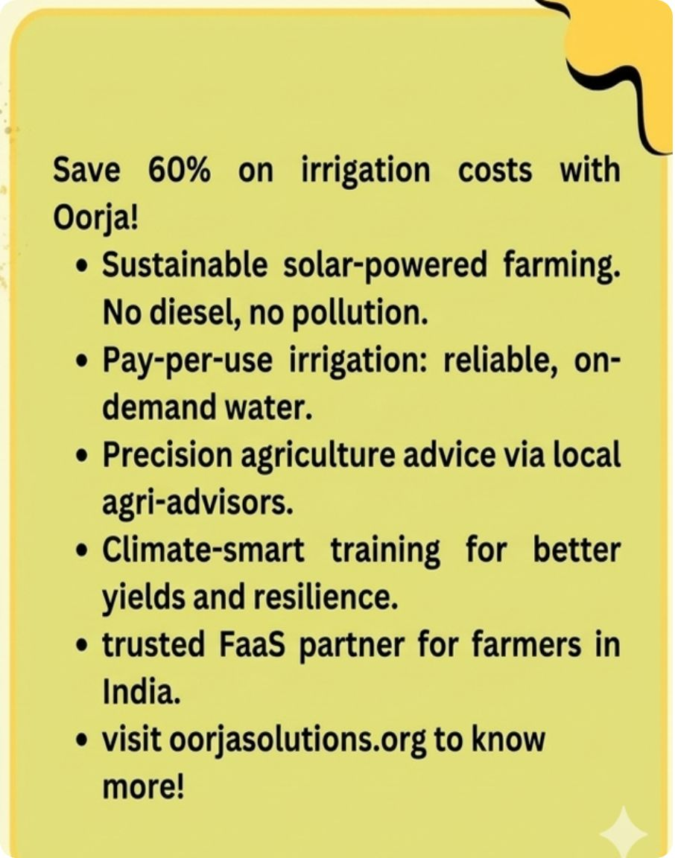
SMS marketing
SMS design
Message design
SMS message
Save 60% on irrigation costs with Oorja!
Sustainable solar-powered farming. No diesel, no pollution.
Pay-per-use irrigation: reliable, on-demand water.
Precision agriculture advice via local agri-advisors.
Climate-smart training for better yields and resilience.
Trusted FaaS partner for farmers in India.
Visit oorjasolutions.org to know more!
Link
Home - Oorja

Slide 69
Landing page structure
Section
Content idea
Headline: Powering Productivity, Growing Resilience Across Rural India
Hero section
PARTNER WITH US
EXPLORE OUR SOLUTIONS
Oonnati: Solar-Powered Irrigation-as-a-Service
Oorvar: Climate-Smart Farmer Advisory Training
Oodyam: Solar-Powered Agro-Milling Utility Services
Popular categories
Zero Upfront Cost: Pay-Per-Use model removes asset purchase barriers
Massive Cost Reductions: Farmers save up to 60% on irrigation expenses
Diesel Independence: 87% of active customers no longer use diesel pumps
USP highlights
Deploy: Community solar hubs are installed in agricultural clusters
Subscribe: Low-income smallholders sign up for flexible volumetric services
Grow: Farmers access clean energy and advice to maximize harvest revenue
How it works

Slide 70
Landing page structure (continued)
Section
Content idea
Video stories: Smallholder video case studies from states like Uttar Pradesh.
Success metrics: Verified data, such as the 33% average rise in agricultural revenue for user farms.
Impact stats: Milestone where 87% of customers permanently stop using diesel pumps.
Testimonials & reviews
FaaS portal intro: Raise awareness of Oorja's field operator tools and digital monitoring systems.
Service enrollment: One-click online or call-based forms to sign up for Oonnati or Oorvar memberships.
Digital growth hub: Localized agro-advisory consultation booking steps on the platform.
App & digital promotion
Quick navigation links: Menu anchors for About Us, Impact, Partnerships, Case Studies, and Careers.
Direct channels: Contact lines for info@oorjasolutions.org and the New Delhi corporate office.
Compliance block: Official identification tags: Oorja Development Solutions Limited.
Contact & info hub

Slide 71
Section
KPIs, accountability & team structure

Slide 72
KPIs used in journey
Journey stage
Category
Key performance indicators (KPIs)
Awareness
Reach & visibility
Monthly website traffic trends, organic keyword visibility, and brand search volume.
Interest
Engagement & curiosity
Average session duration, case study reading rates, and promotional farm video views.
Consideration
Intent
Ad click-through rates (CTR) and clicks on the "Get In Touch" partner buttons.
Conversion
Transactions
Memberships activated for Oonnati solar pumps and sign-ups for Oorvar training.
Delivery & fulfillment
Experience
Total solar pumps deployed and inline volumetric meter reading accuracy.
Retention
Repeat use
Seasonal subscription renewal rates and customer engagement with automated WhatsApp/SMS loops.
Advocacy
Reputation
Village word-of-mouth farmer referrals and the percentage of users permanently ditching diesel.

Slide 73
SEO KPIs to track
01
02
04
03
Organic traffic
Conversion rate
Keyword rankings
Crawlability
05
06
07
08
Quality of inbound links
Local SEO metrics
Click-through rate
UX performance

Slide 74
SEO KPIs to track (continued)
12
09
10
11
Domain authority
Site ranking
Bounce rate
Page speed
13
Session duration and pages per session
14
15
Indexed pages
Contain

Slide 75
Organisation team structure
Approx. 8 - 10 people working on the project
Social media
SEO
PPC
→
→
2+
2+
↗
2+
Project manager
↓
1+
↘
Content
Creative
→
←
2+
2+

Slide 76
Organisation team structure: leadership
→
SEO
Strategist
→
Social media
↓
→
PPC
Project managers
Digital marketing heads (all departments)
→
Motion graphic
→
→
→
Animation
→
Content
→
Copyright
2 level of POC
→
Tech

Slide 77
Project governance and accountability
Defining scope & responsibilities
↓
Performance tracking & reviews (weekly/monthly)
Setting goals & metrics
Transparent execution

Slide 78
Project governance and accountability (continued)
Schedule adherence & milestones
↓
Resource & budget optimization
Stakeholder feedback & iteration
Ethical digital practices & compliance

Slide 79
Thank you
Thanking you all
Oorja Solutions
oorjasolutions.org

